Slide 1
Welcome
Don Bosco Arts and Science College
Library
lib.donbosco.ac.in

Slide 2
Library Statistics
Total Volumes : 19371
Total Titles : 15897
Periodicals : 38
Journals : 27
Newspapers : 7

Slide 3
Library Sections
Ground Floor
Circulation
Stack Room
Periodicals
Reading Area
OPAC
First Floor
Reference
Digital Library
Bound Volume

Slide 4
Library Working Hours
8.30 am to 6.30 pm
Stack Room
9 am to 5 pm
Circulation
9 am to 5 pm

Slide 5
Library Rules
LIBRARY USERS SHOULD SUBMIT THEIR IDENTITY CARD TO THE LIBRARIAN WHENEVER NECESSARY
KEEP YOUR BELONGINGS IN THE PROPERTY COUNTER WHEN YOU ENTER THE LIBRARY
ENTER YOUR ADMISSION NUMBER IN ‘LIBRARY USER LOG ENTERY’ IN THE COMPUTER AT THE ENTRANCE, WHEN YOU COME IN AND GO OUT OF THE LIBRARY. STUDENTS WHO DO NOT MAKE THIS ENTRY WILL BE ASKED TO GO OUT OF THE LIBRARY
DO NOT BRING YOUR BOOKS OR NOTEBOOKS INSIDE THE LIBRARY. YOU ARE ALLOWED TO BRING LOOSE PAPER SHEETS/REFERENCE CARDS.
KEEP SILENCE IN THE LIBRARY
BORROWER’S ID CARD IS NOT TRANSFERABLE. ENSURE THAT OTHERS DO NOT USE YOUR BORROWER CARD. YOU WILL BE RESPONSIBLE FOR THE BOOKS ISSUED IN YOUR CARD
TIME OF BOOK ISSUE WILL BE FROM 9.00 AM TO 5.00 PM

Slide 6
Rules continues…
BOOKS ARE ISSUED TO MEMBERS FOR 14 DAYS AND YOU CAN RENEW IT FOR ONE TIME. BOOKS ISSUED CAN BE RECALLED AT ANY TIME IF NECESSARY
FOUR BOOKS ARE ISSUED TO POSTGRADUATE STUDENTS AND THREE BOOKS TO DEGREE THIRD YEARS AND TWO BOOKS TO DEGREE FIRST AND SECOND YEARS
A FINE OF RUPEE 1 PER DAY PER VOLUME WILL BE CHARGED, IF BOOKS ARE NOT RETURNED OR RENEWED IN TIME
BOOKS LOST, TORN, DEFACED, MARKED OR DAMAGED IN ANY WAY SHALL HAVE TO BE REPLACED BY THE BORROWER OR SHALL HAVE TO BE PAYED THREE TIMES OF PRESENT MARKET COST OF THE BOOK
LABELS ON BOOKS LOST, TORN, DEFACED, MARKED OR DAMAGED IN ANY WAY SHALL HAVE TO BE PAYED A FINE OF RUPEES 5
HELP TO KEEP THE BOOK FRESH AND CLEAN
HANDLE THE BOOKS WITH CARE. CO-OPERATE TO PRESERVE OUR REPOSITORY. TO TEAR OF THE PAGES OF BOOKS/JOURNALS MEANS TO CHEAT YOUR FRIEND WHO IS ALSO IN NEED OF THE INFORMATION CONTAINED IN IT

Slide 7
Rules continues…
REFERENCE BOOKS, JOURNALS PERIODICALS & THESES WILL NOT BE ISSUED ON LOAN. YOUR COLLEAGUE FOR AN URGENT REFERENCE MAY NEED IT. PLEASE DO NOT REQUEST TO ISSUE THEM
USERS ARE REQUIRED TO FOLLOW THE DRESS CODE OF THE COLLEGE IN THE LIBRARY; DOTHI,T-SHIRTS AND THREE FOURTH PANTS WILL NOT BE PERMITTED IN THE LIBRARY
PLEASE DO NOT HESITATE TO TELL YOUR REQUIREMENTS TO THE LIBRARY STAFF
SOLICITING YOUR CO-OPERATION FOR THE EFFICIENT FUNCTIONING OF THE LIBRARY SYSTEM

Slide 8
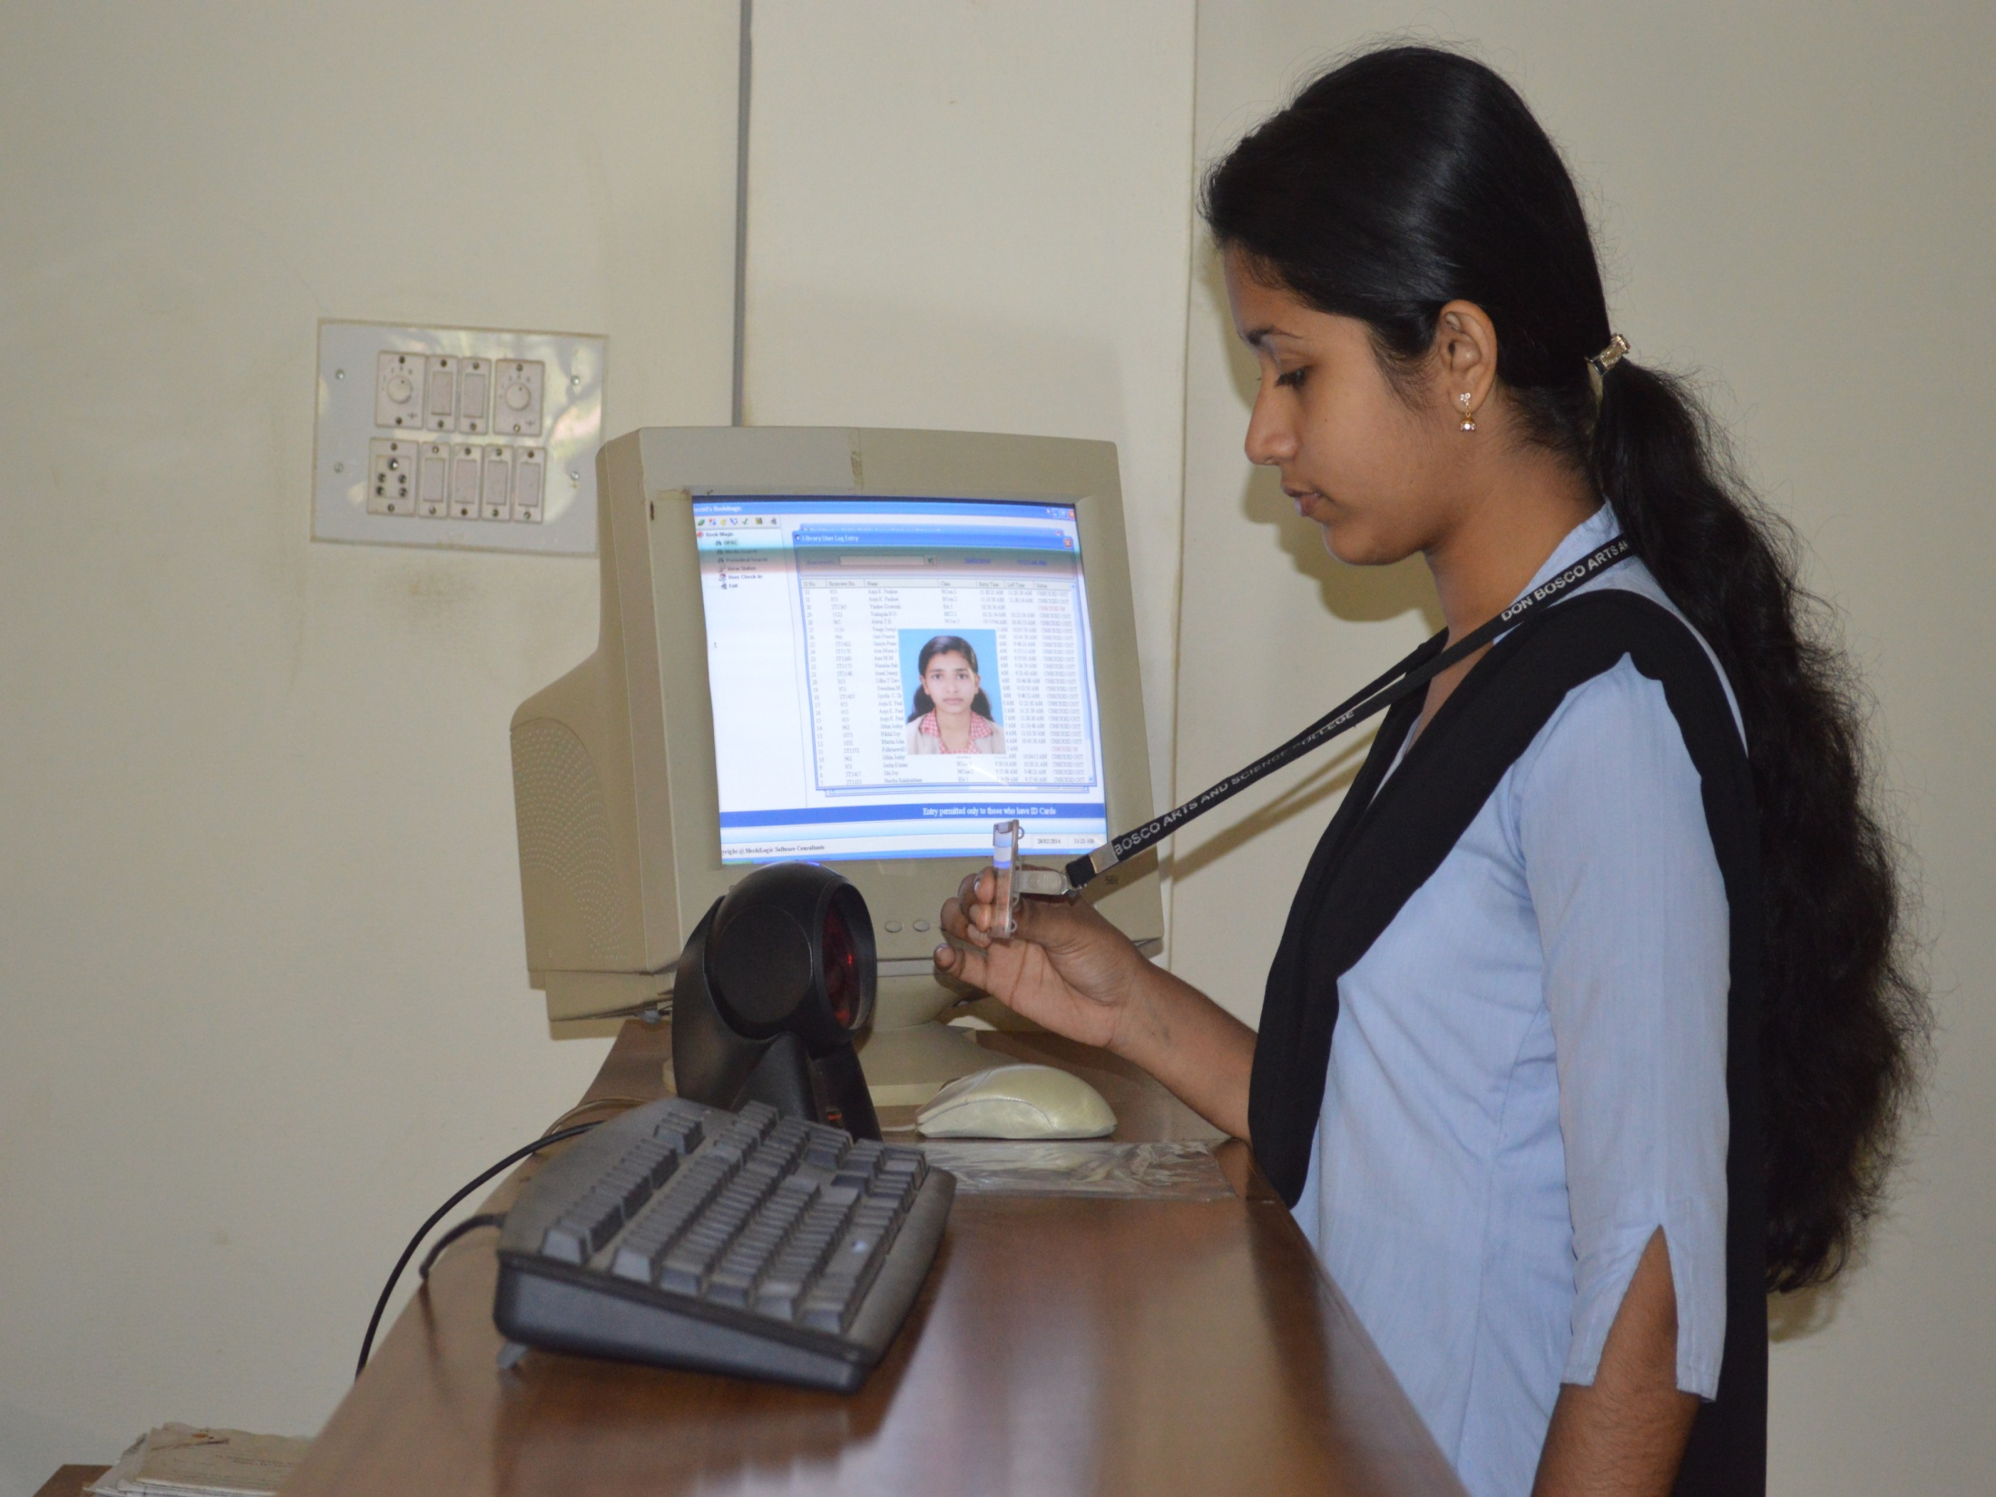

Slide 9
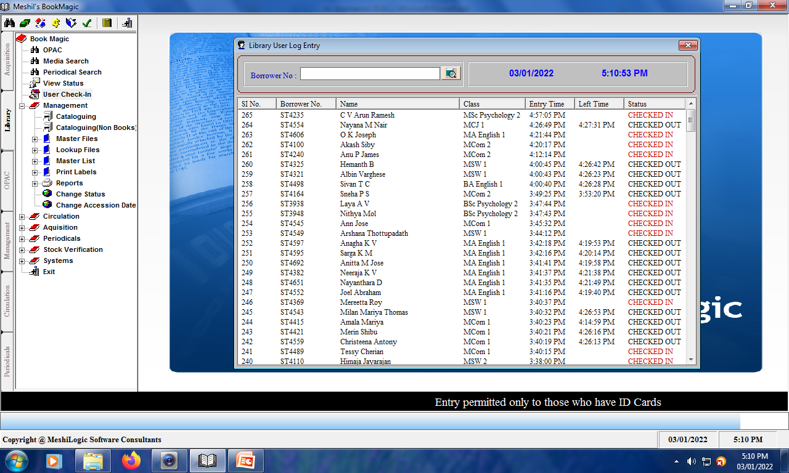

Slide 10
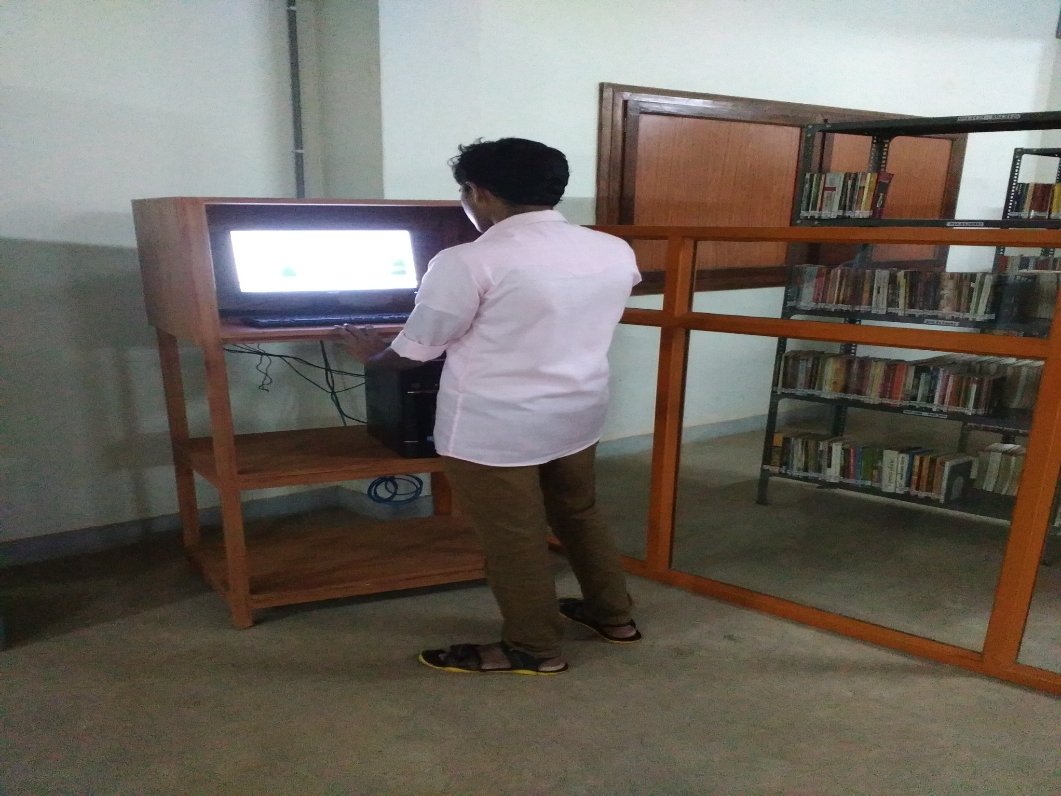

Slide 11
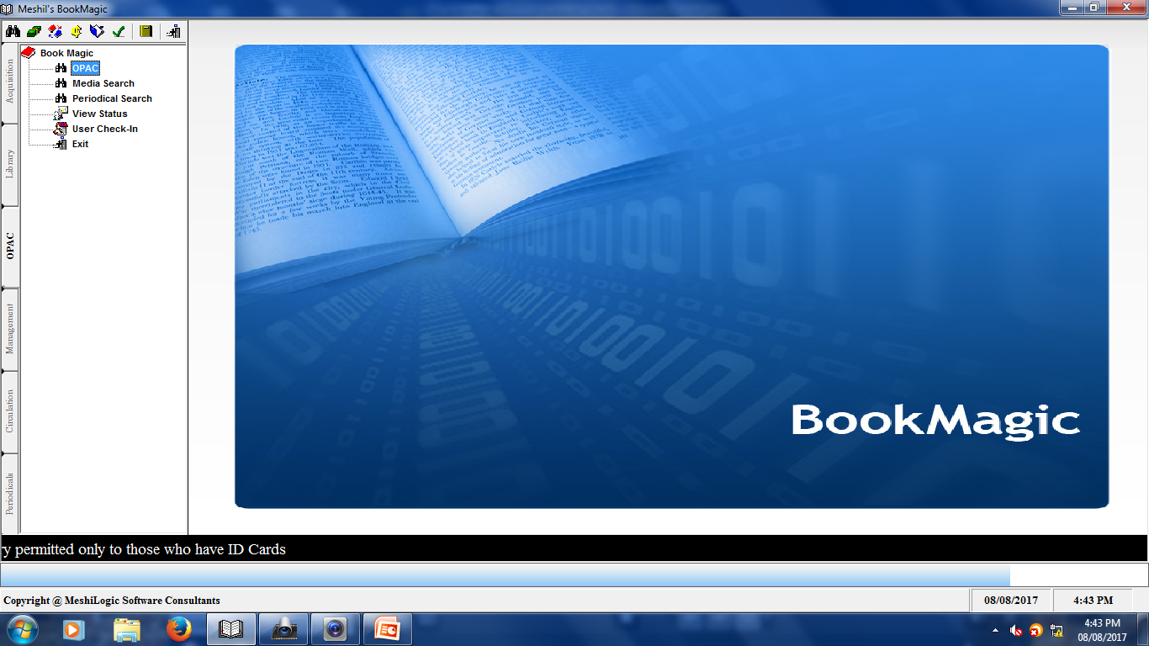

Slide 12
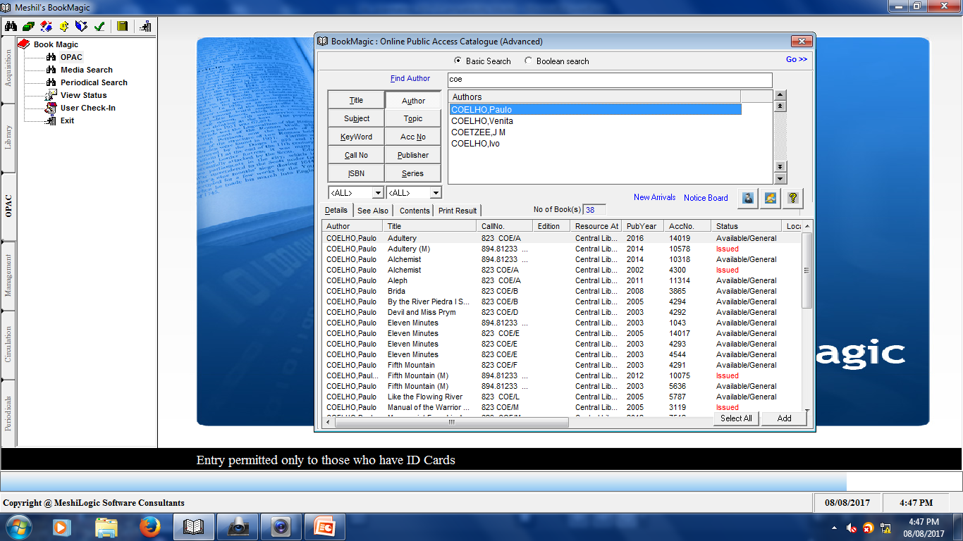

Slide 13
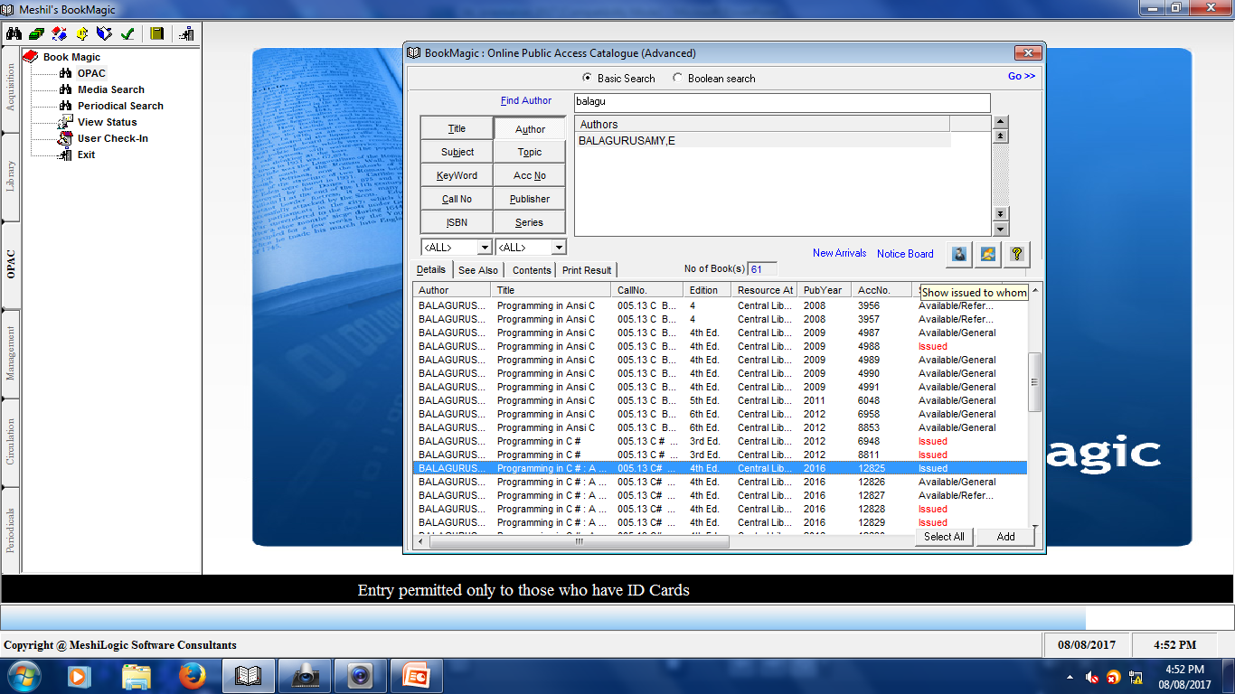

Slide 14
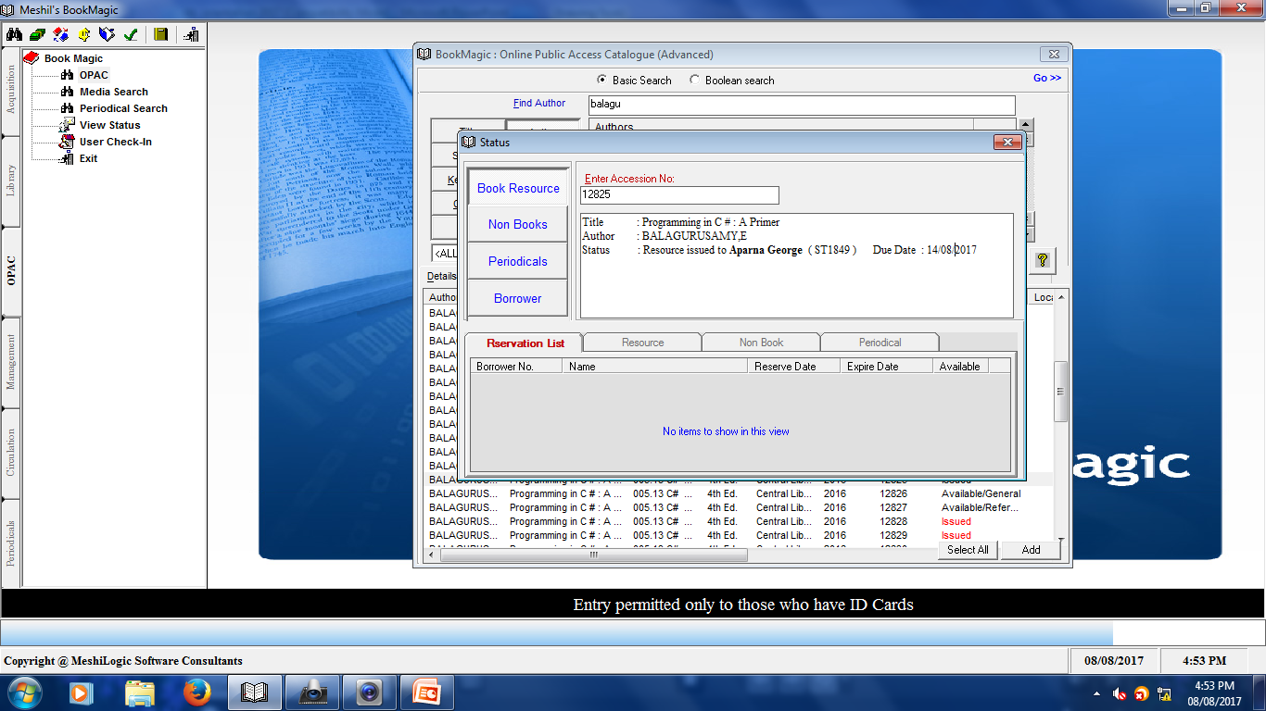

Slide 15
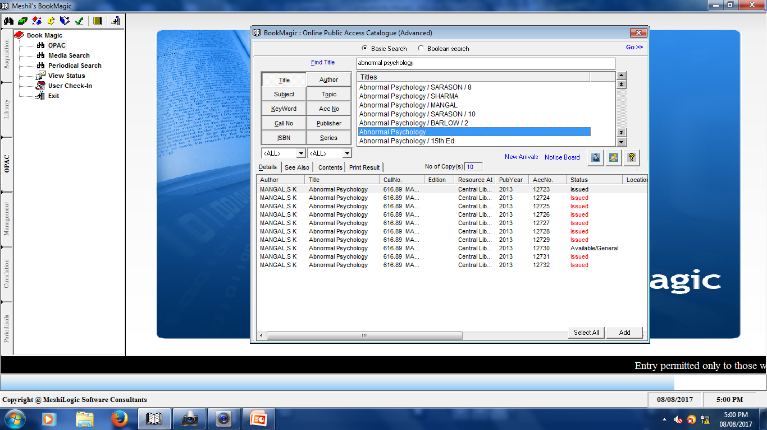

Slide 16
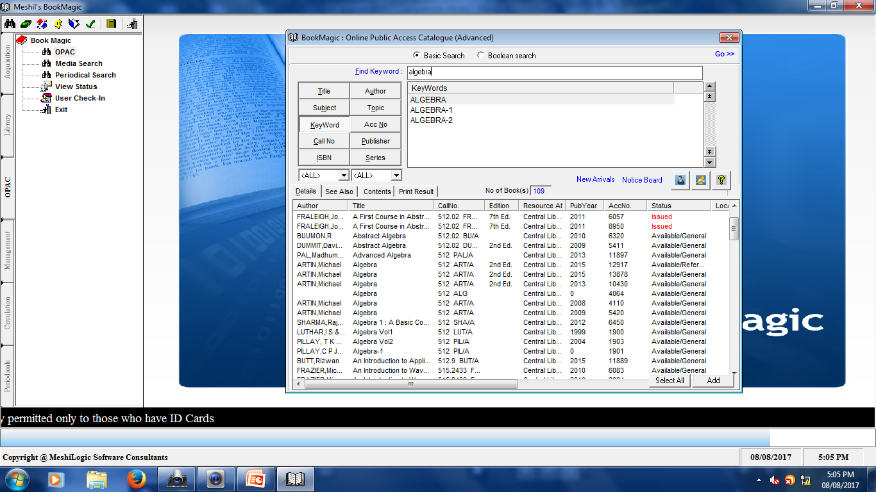

Slide 17
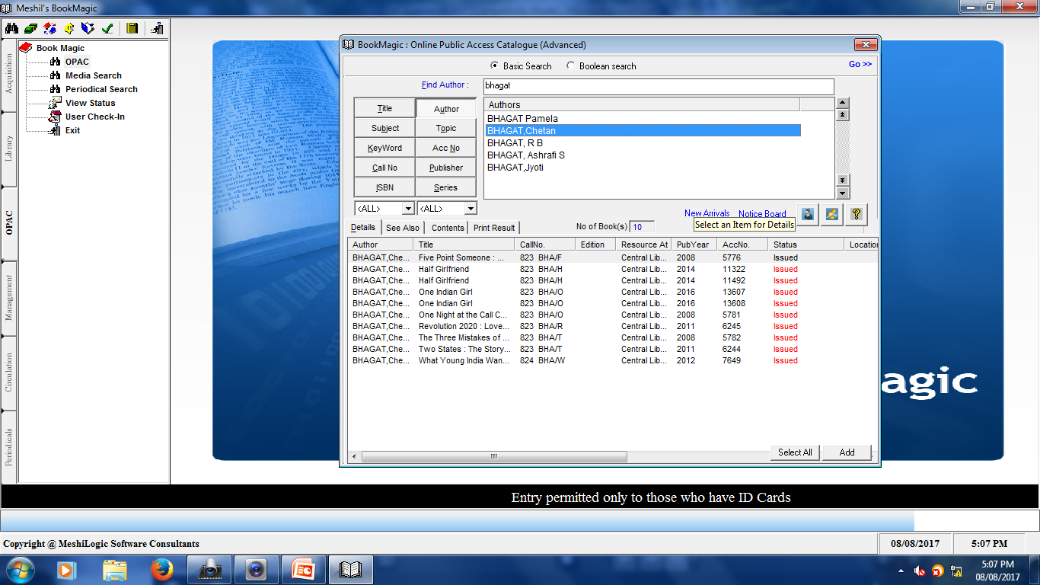

Slide 18
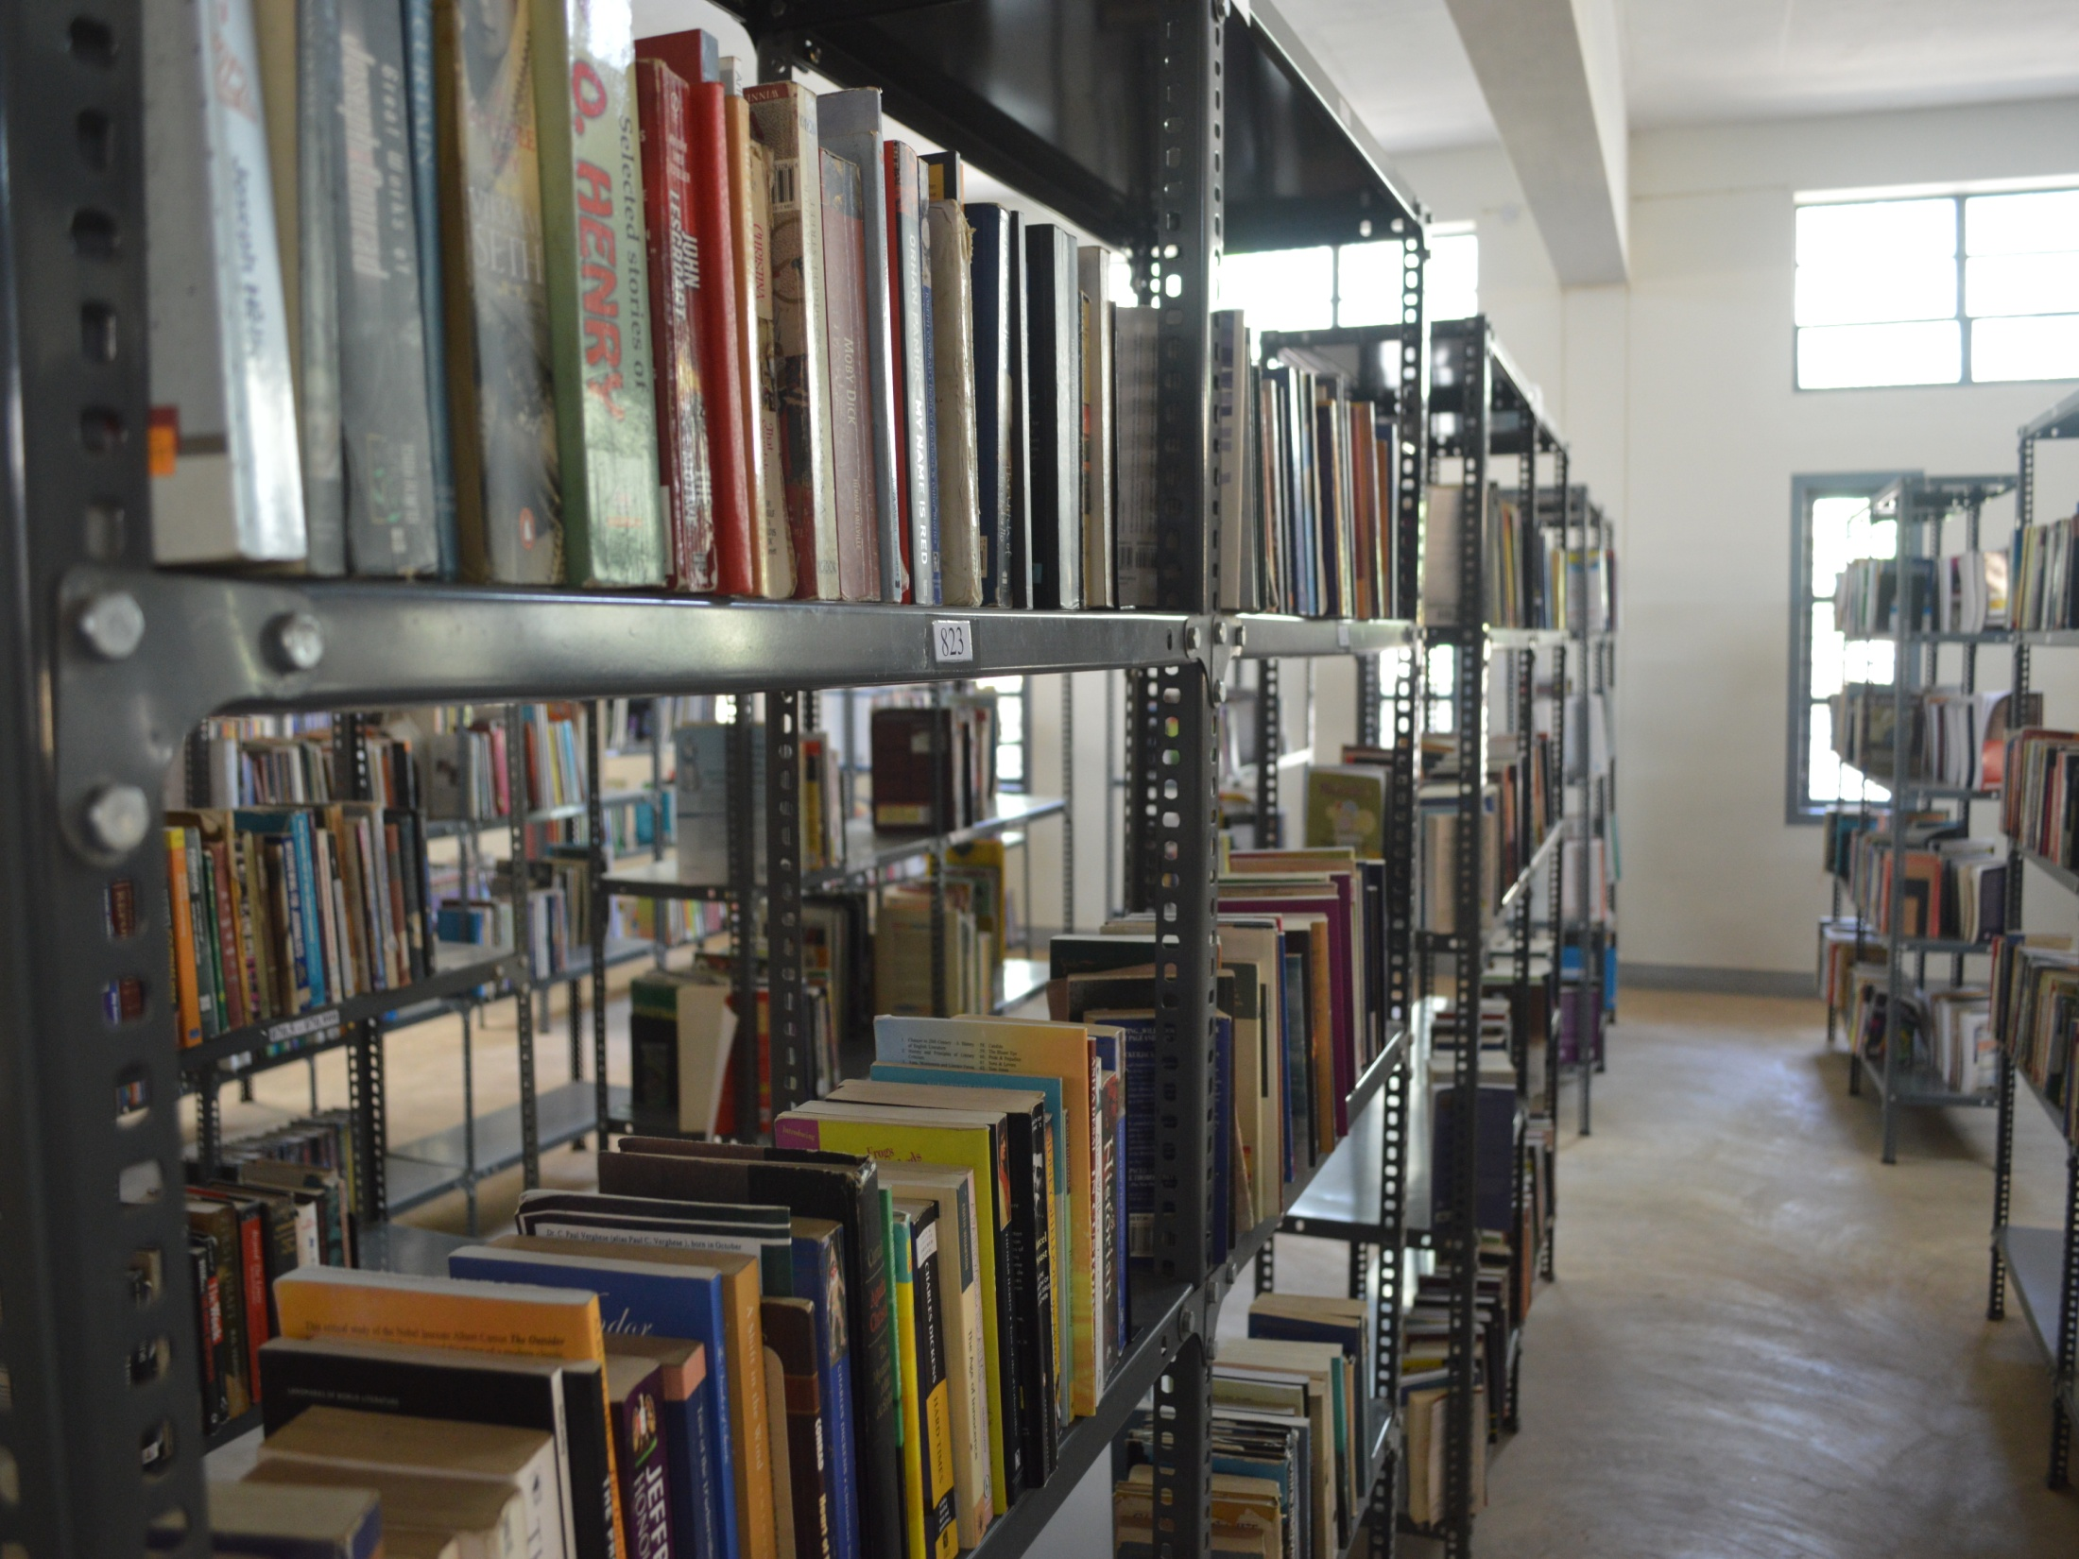

Slide 19
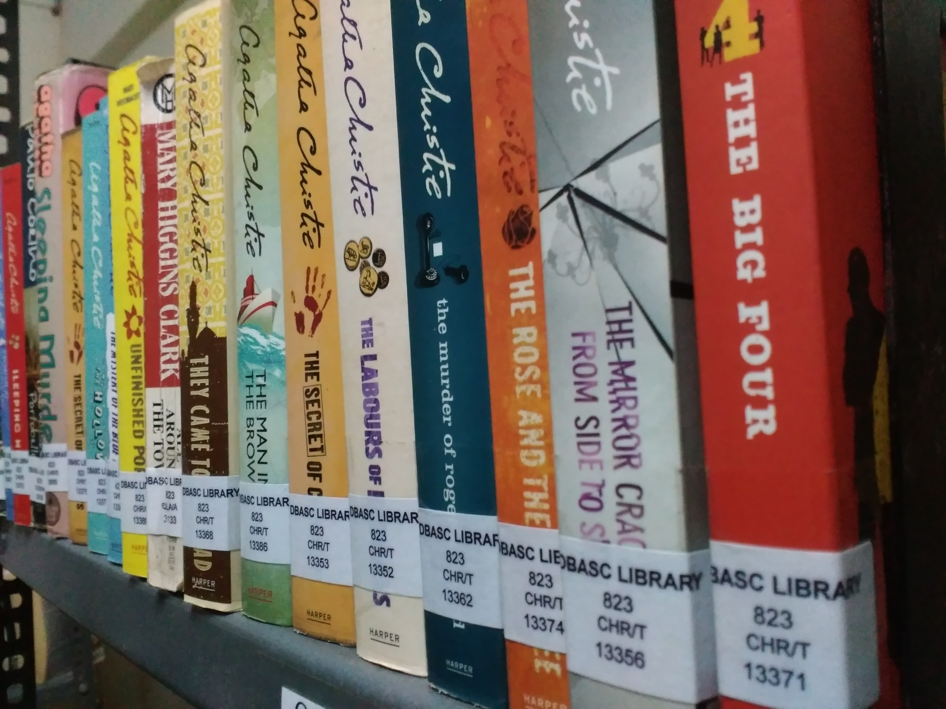

Slide 20
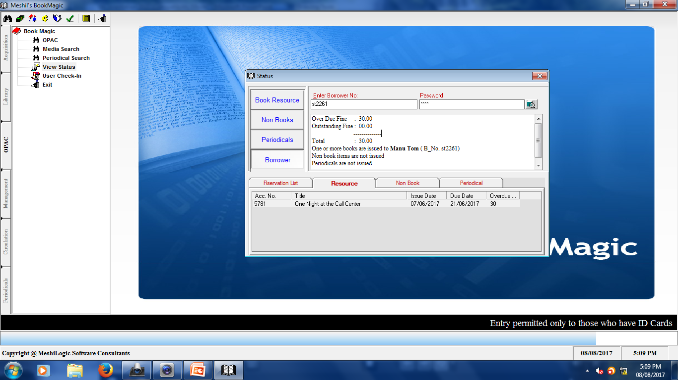

Slide 21
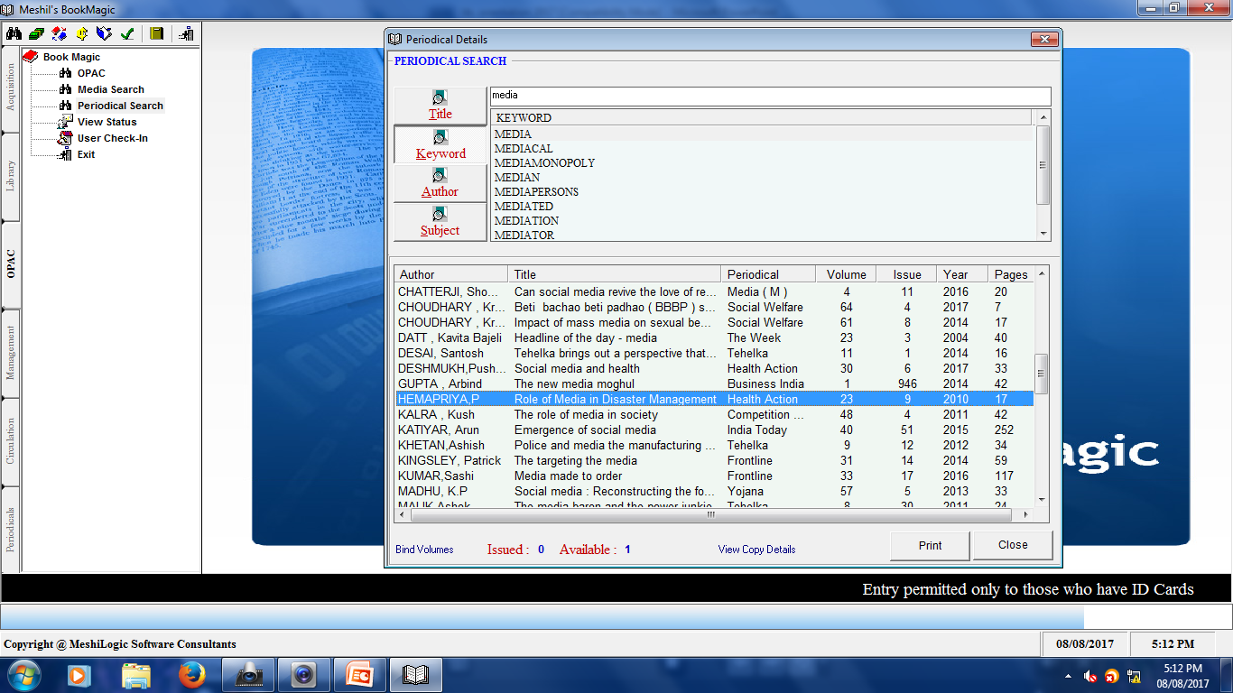

Slide 22
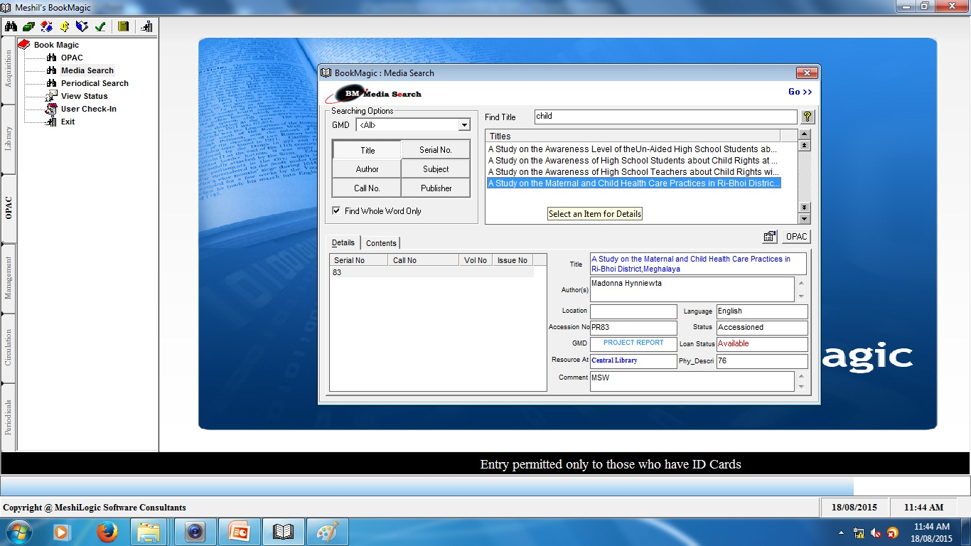

Slide 23
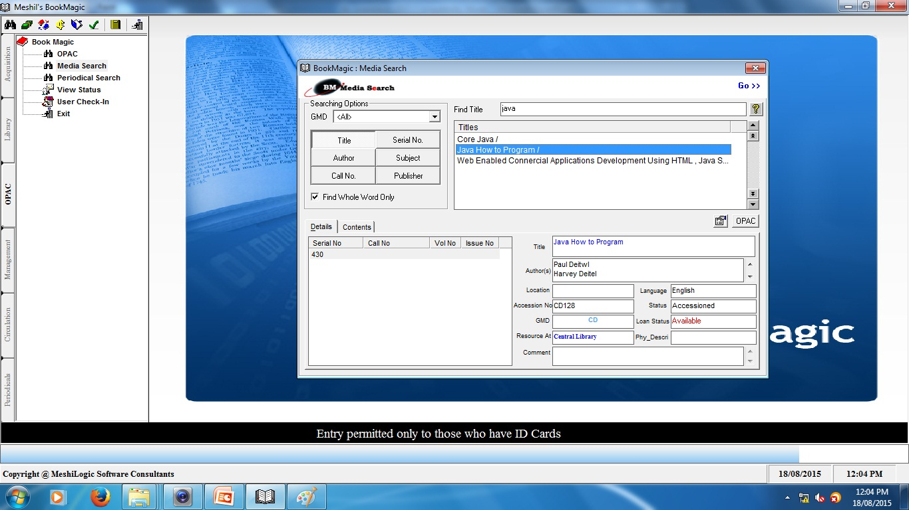

Slide 24
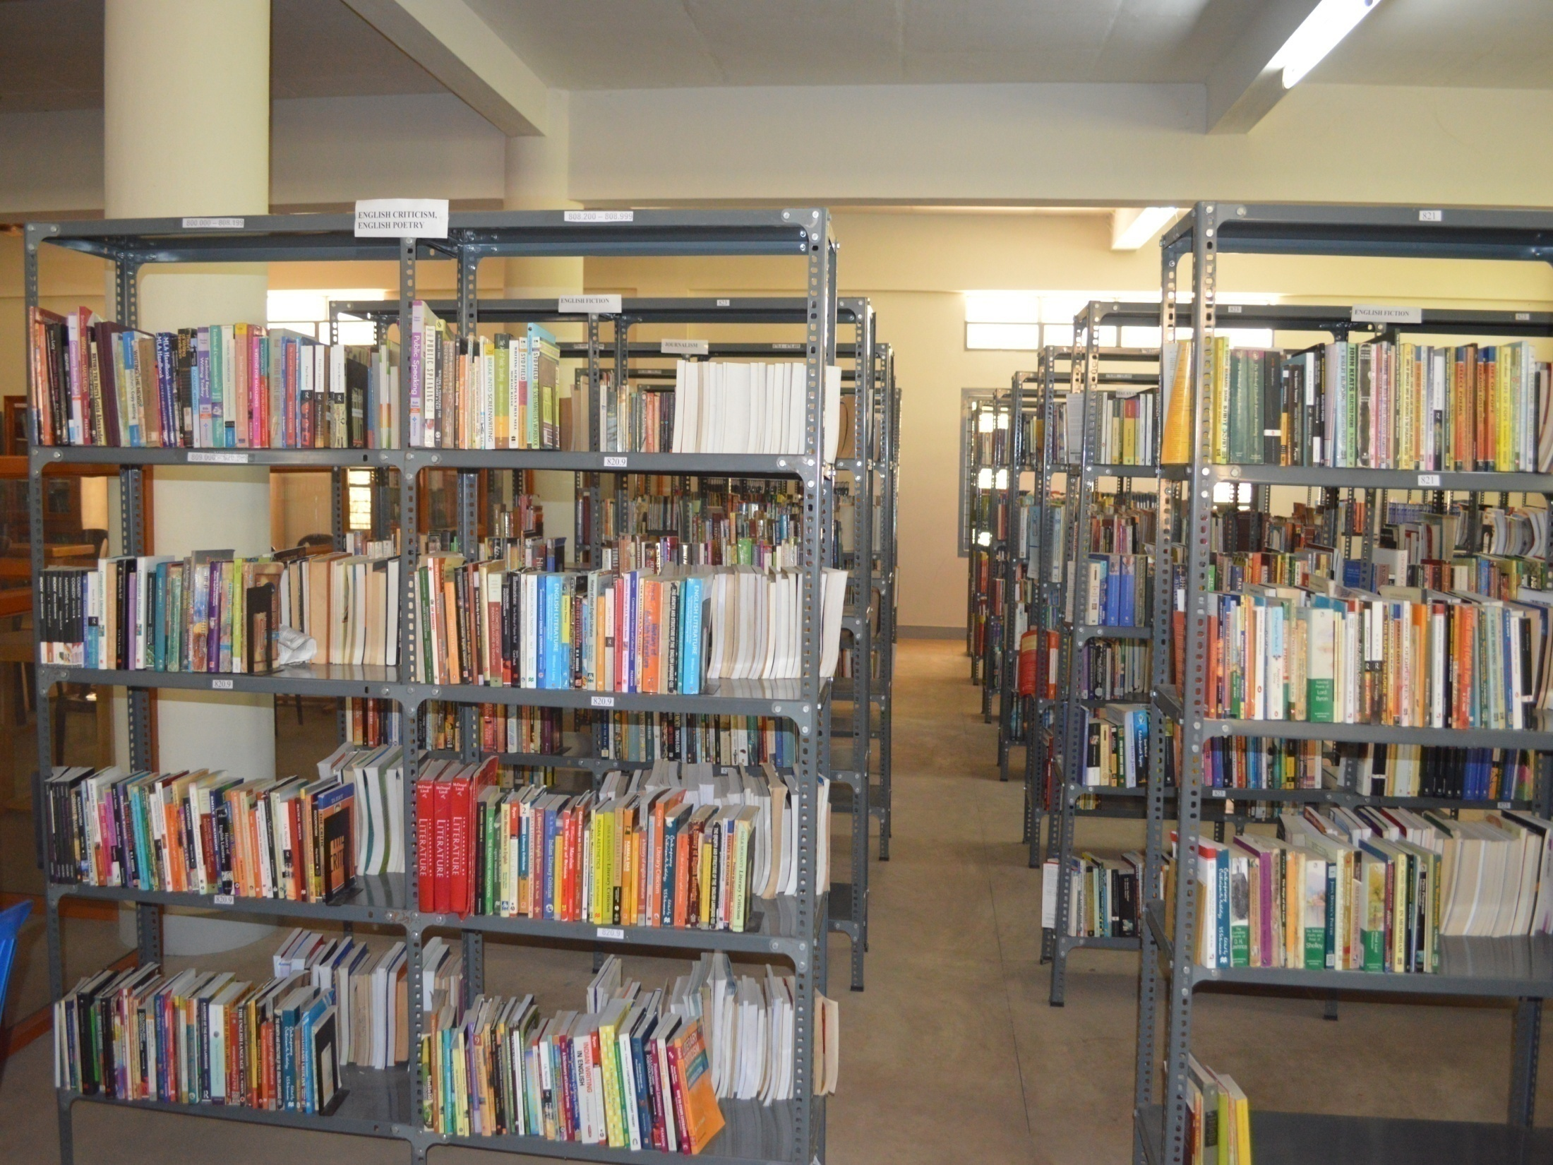

Slide 25
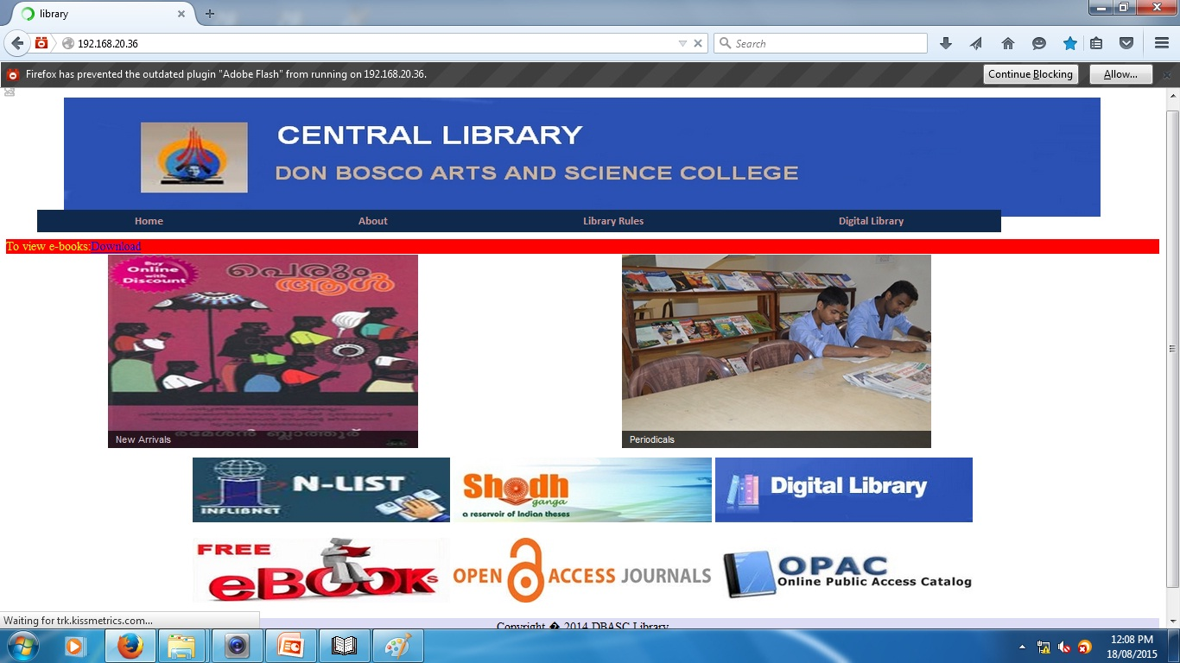

Slide 26
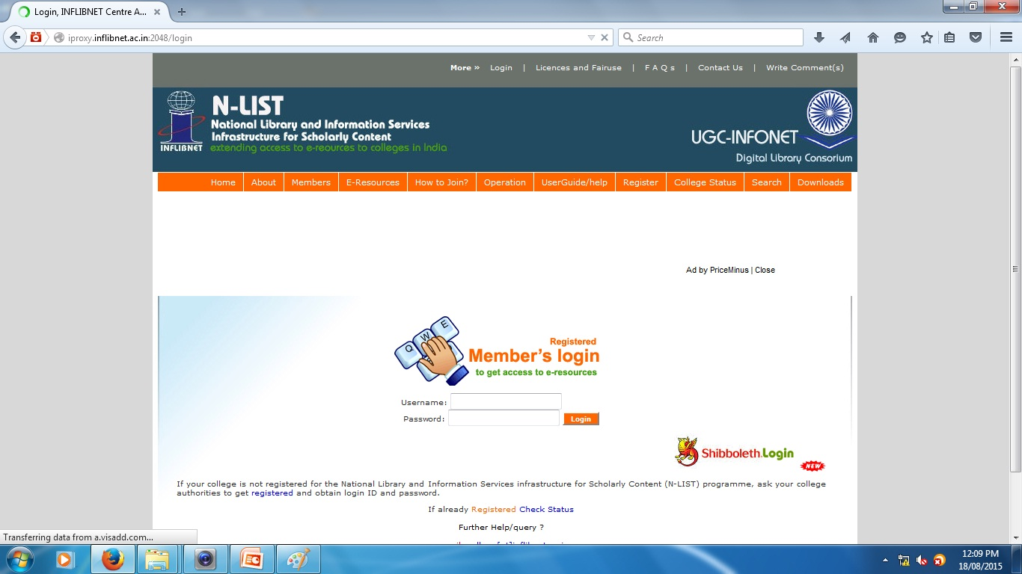

Slide 27
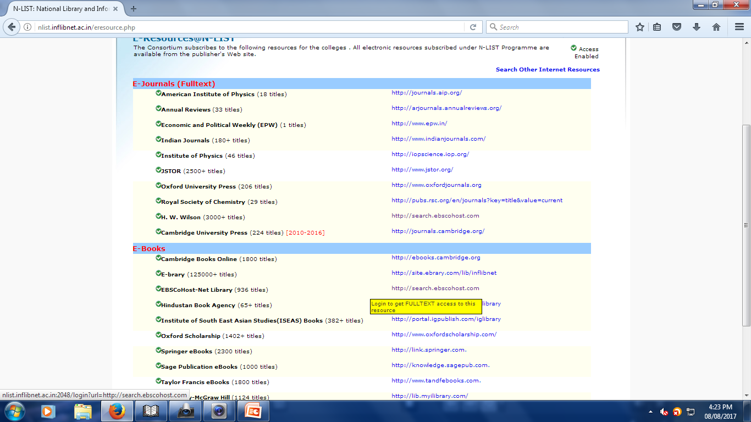

Slide 28
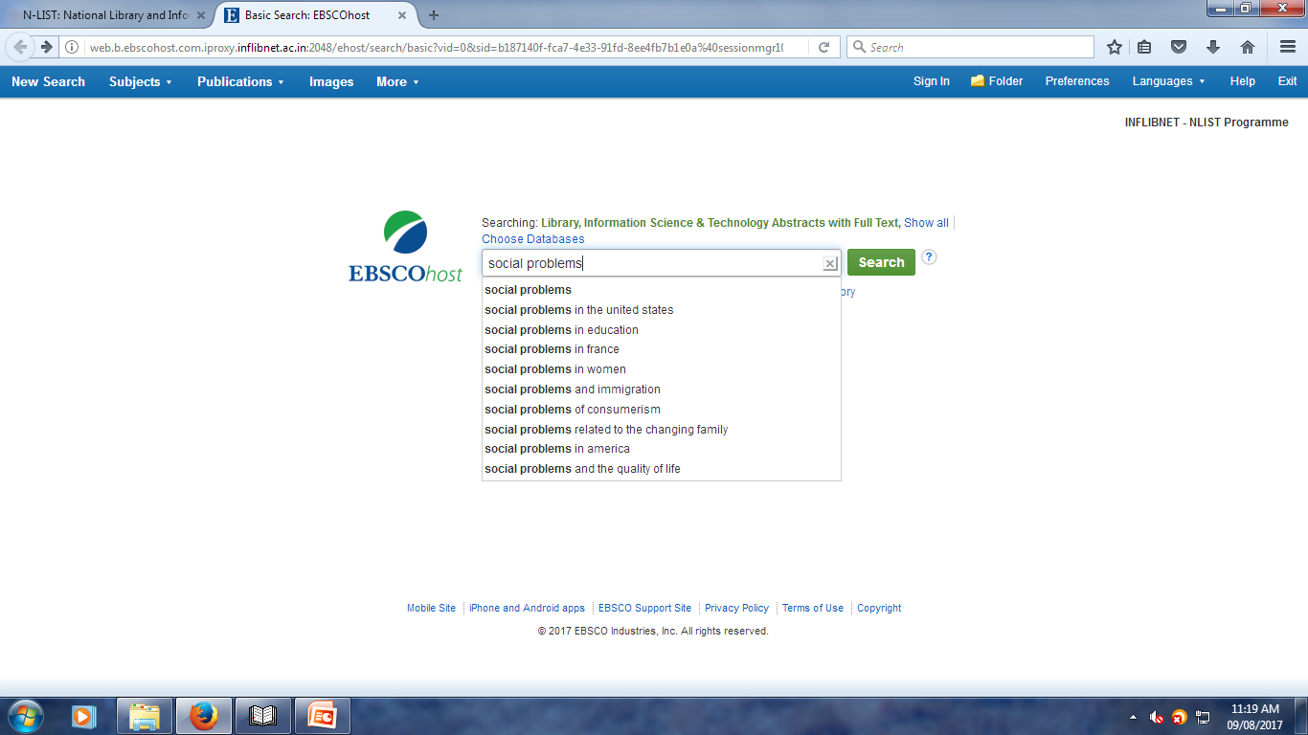

Slide 29
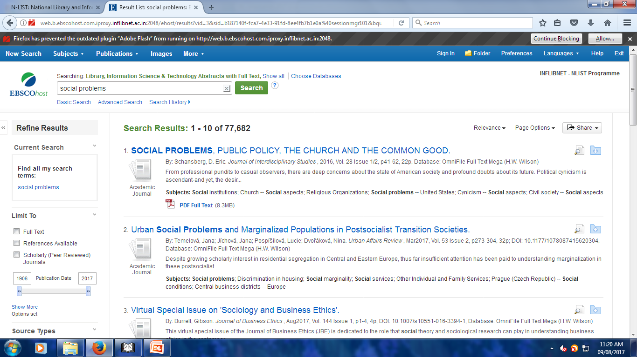

Slide 30
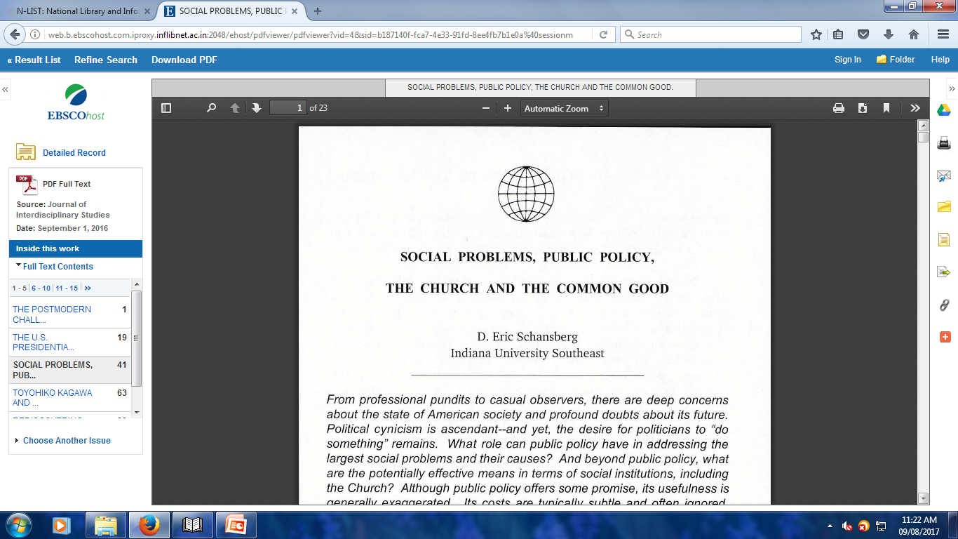

Slide 32
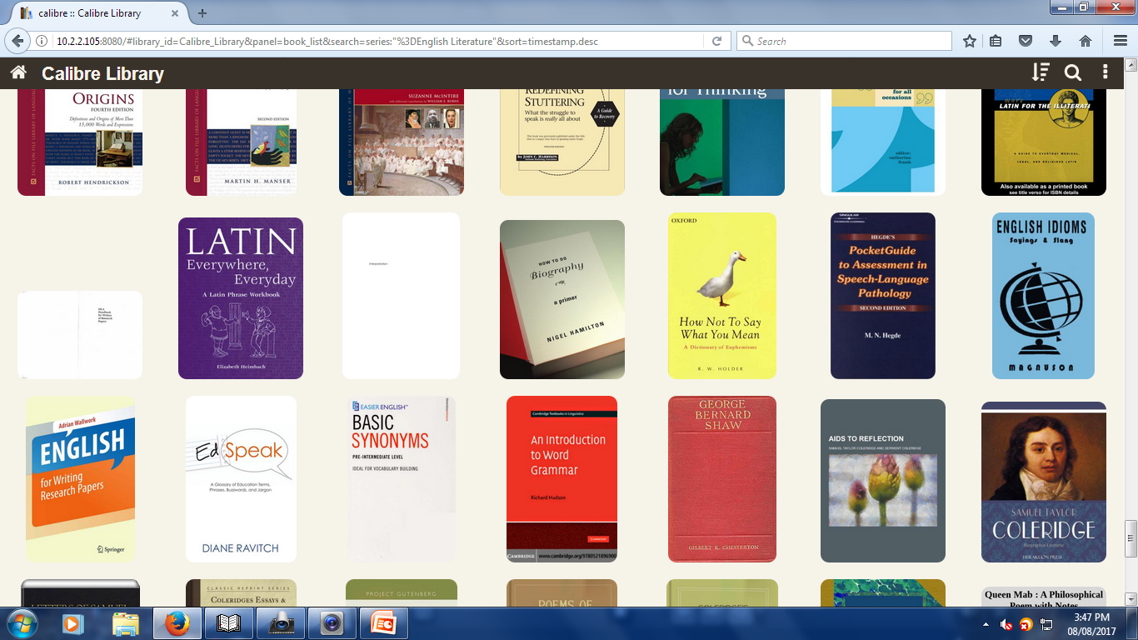

Slide 33
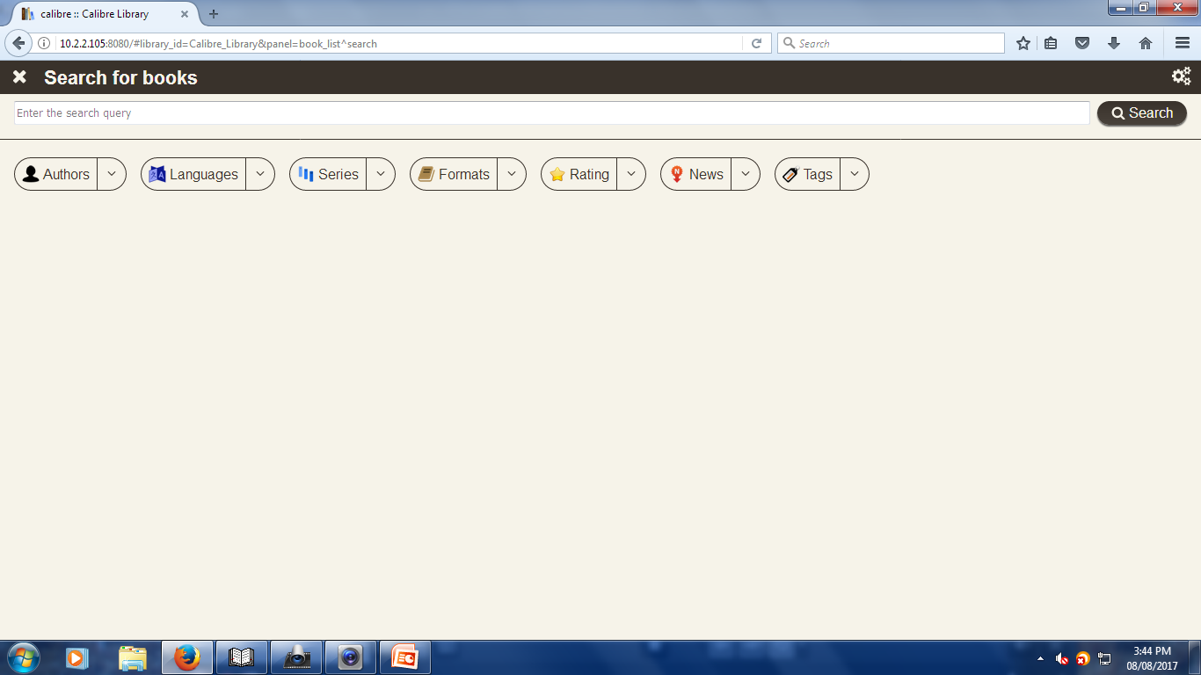

Slide 34
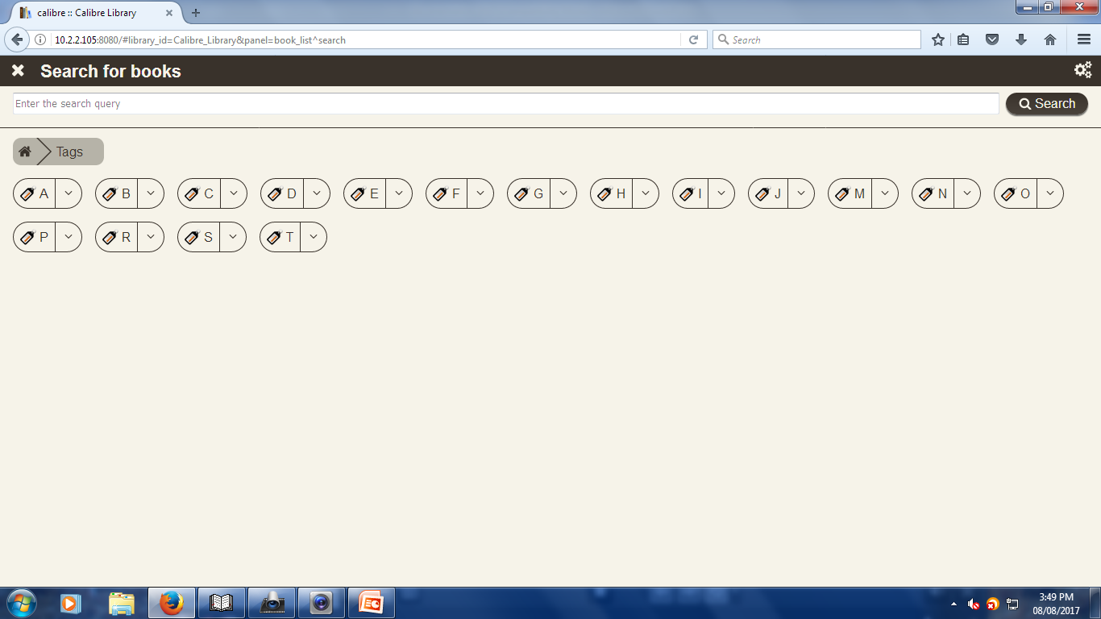

Slide 35
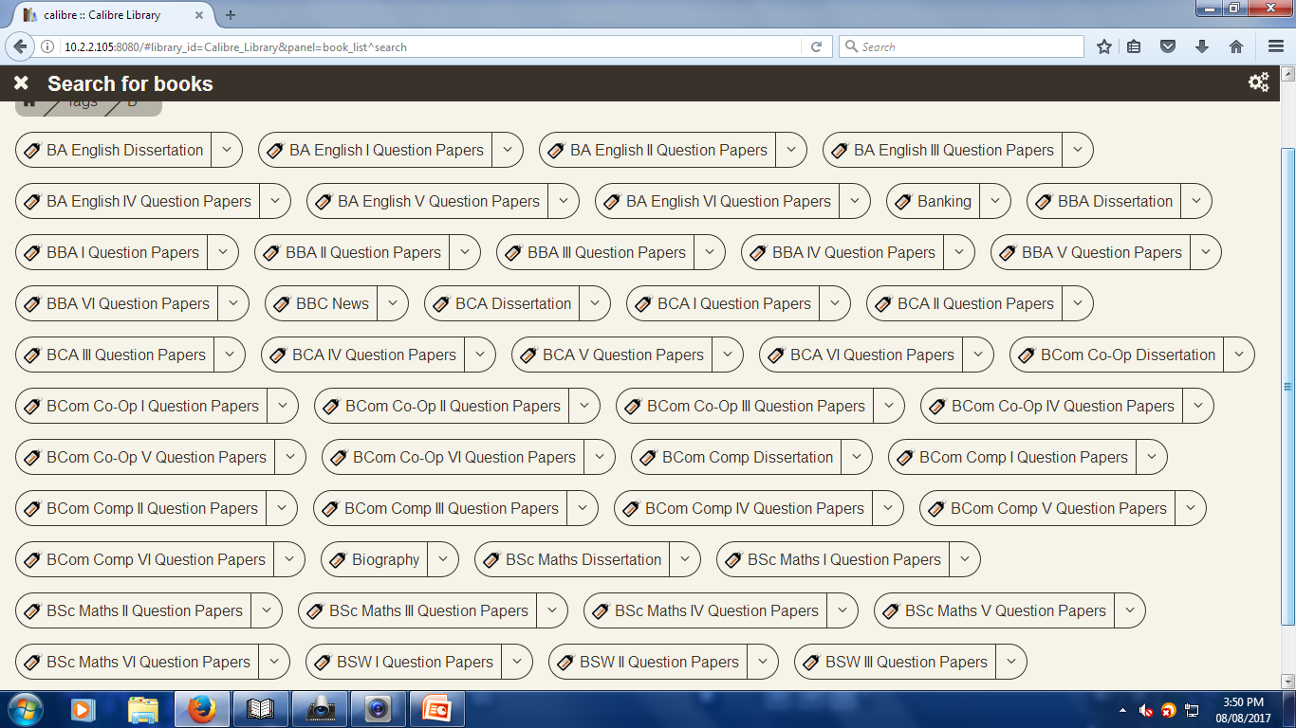

Slide 36
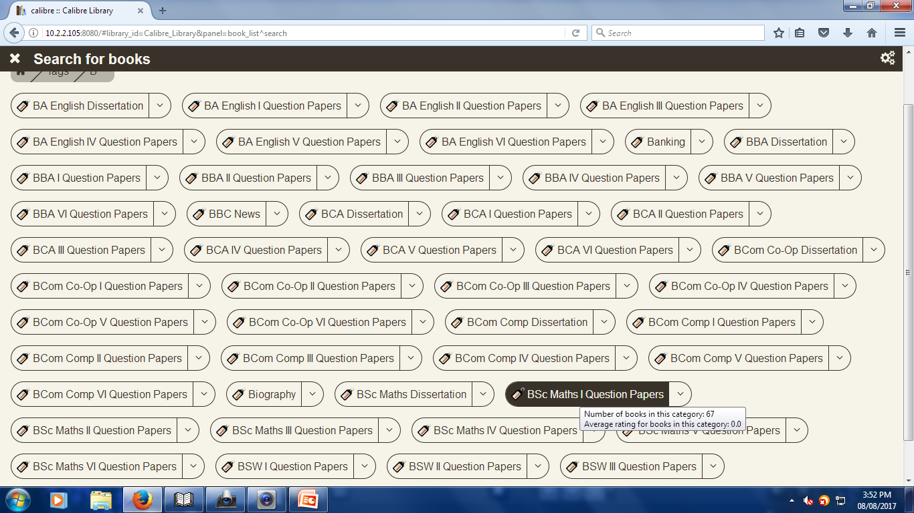

Slide 37
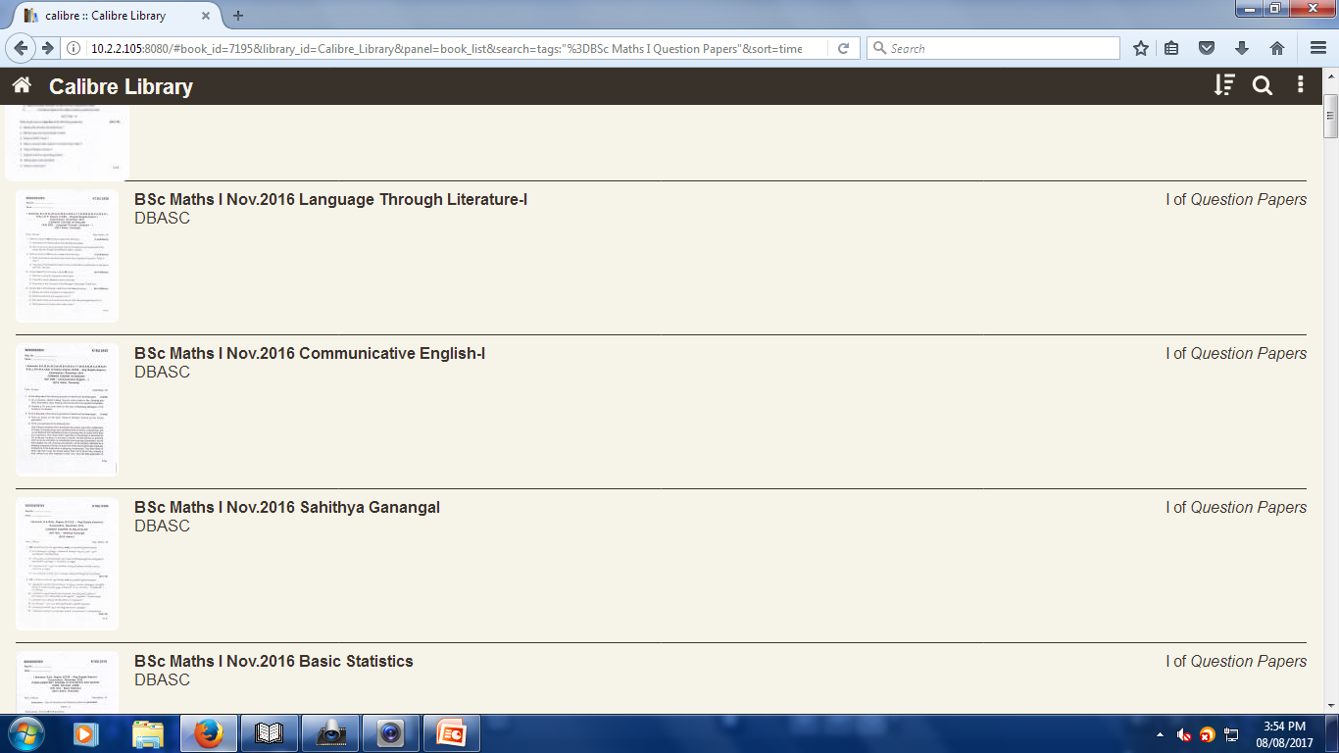

Slide 38
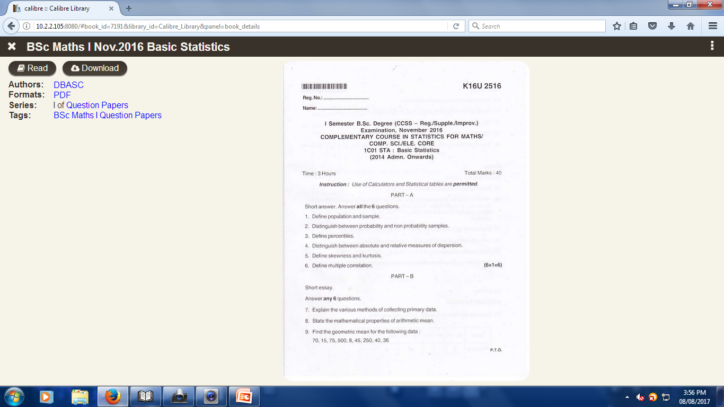

Slide 39
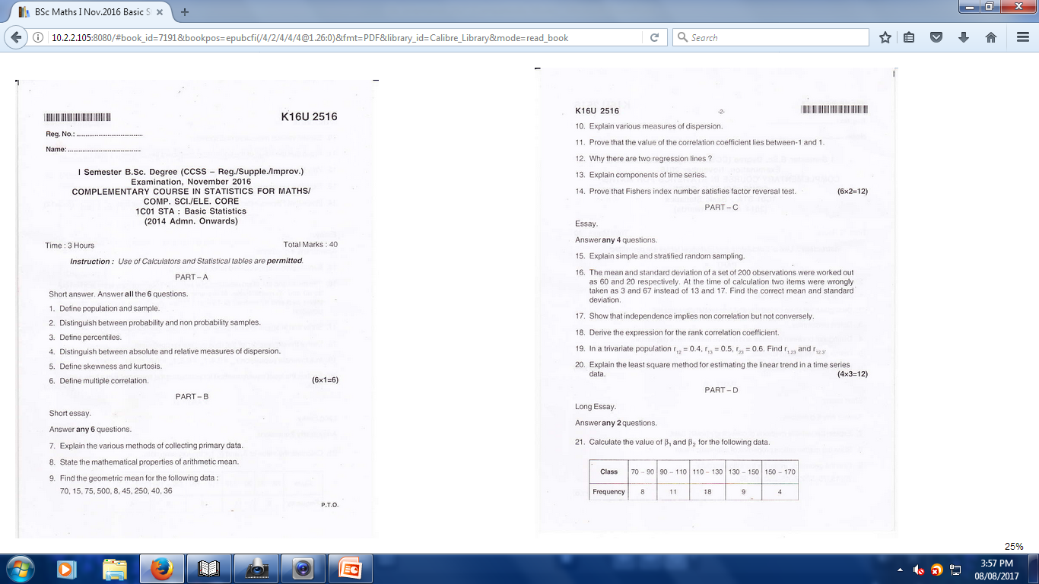

Slide 40
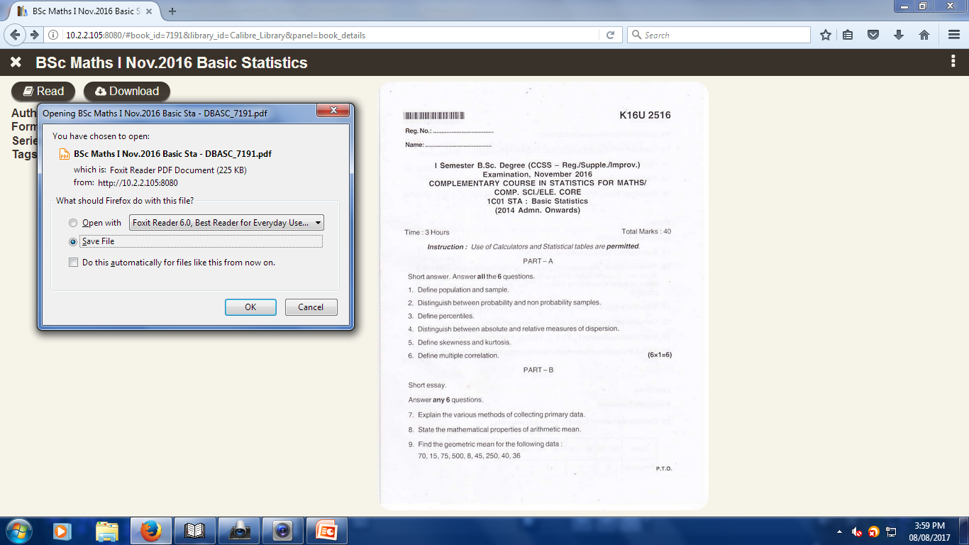

Slide 41
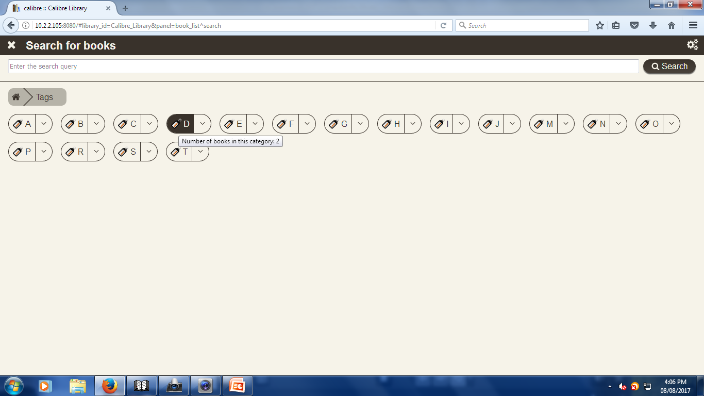

Slide 42
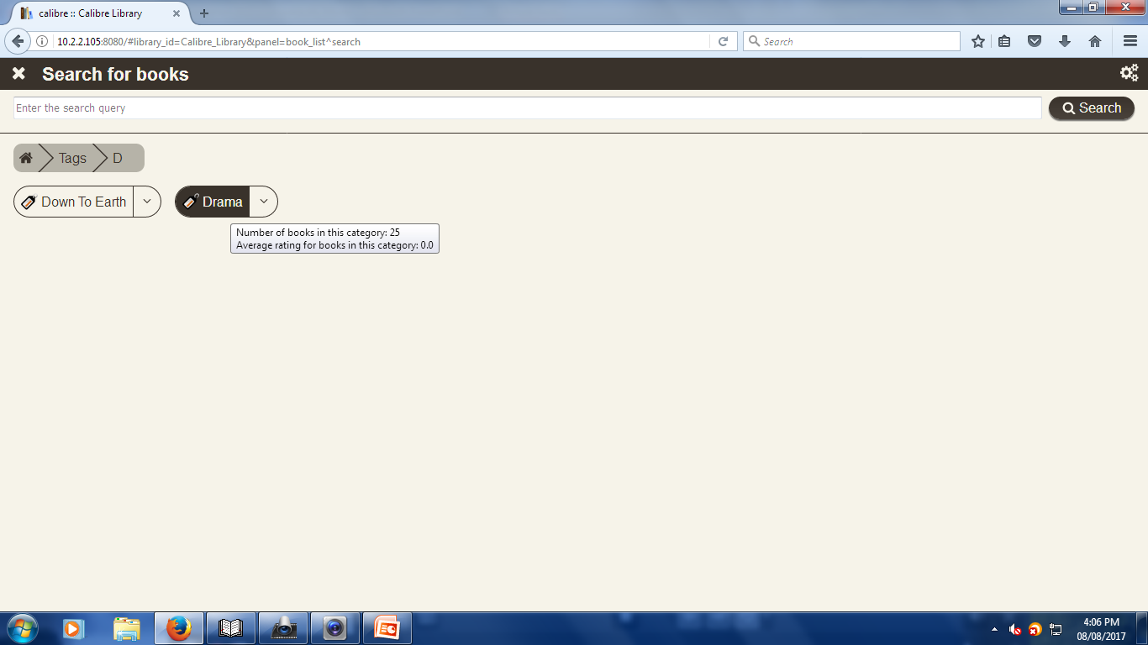

Slide 43
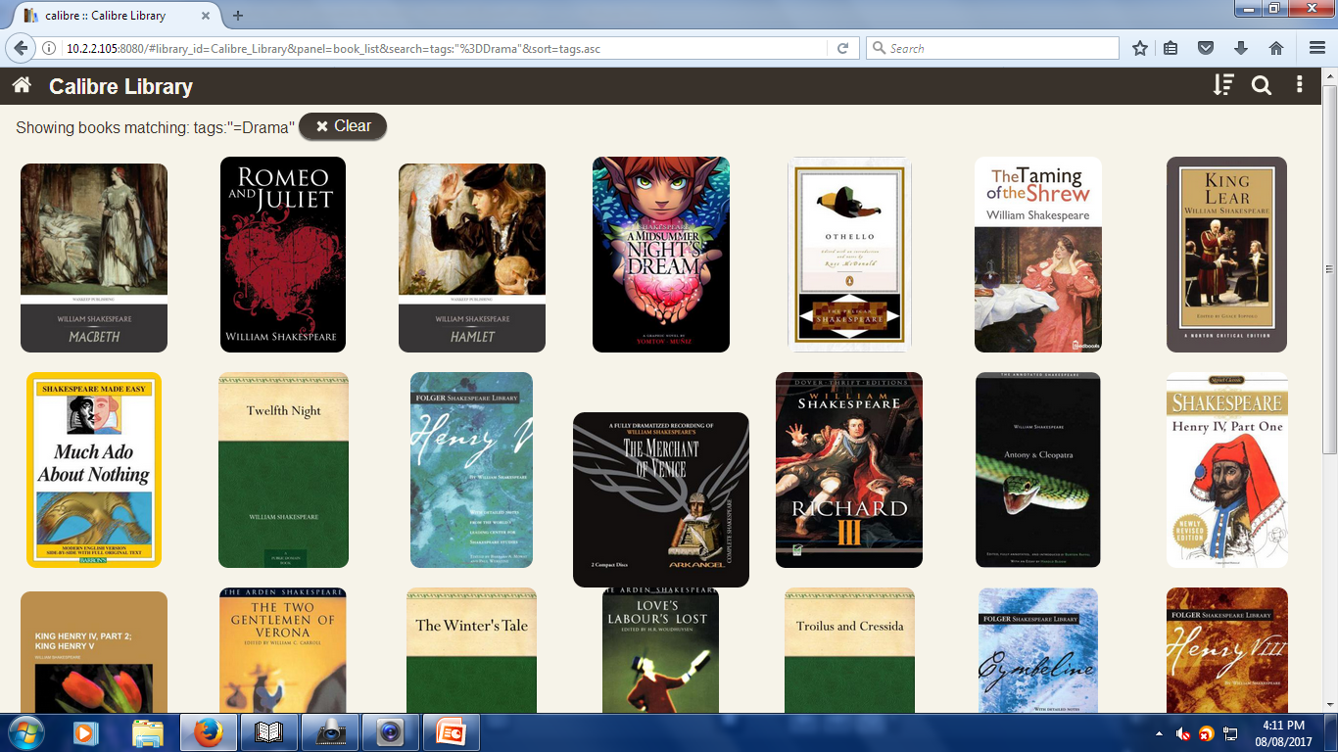

Slide 44
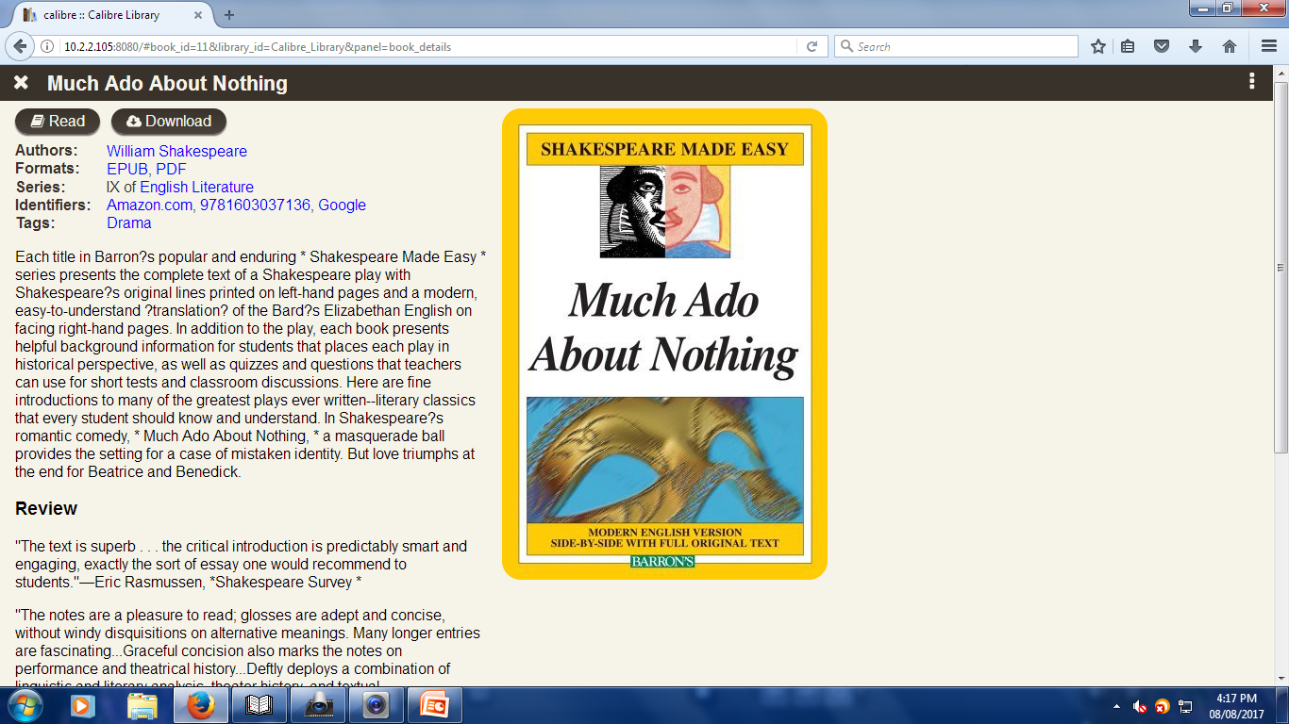

Slide 45
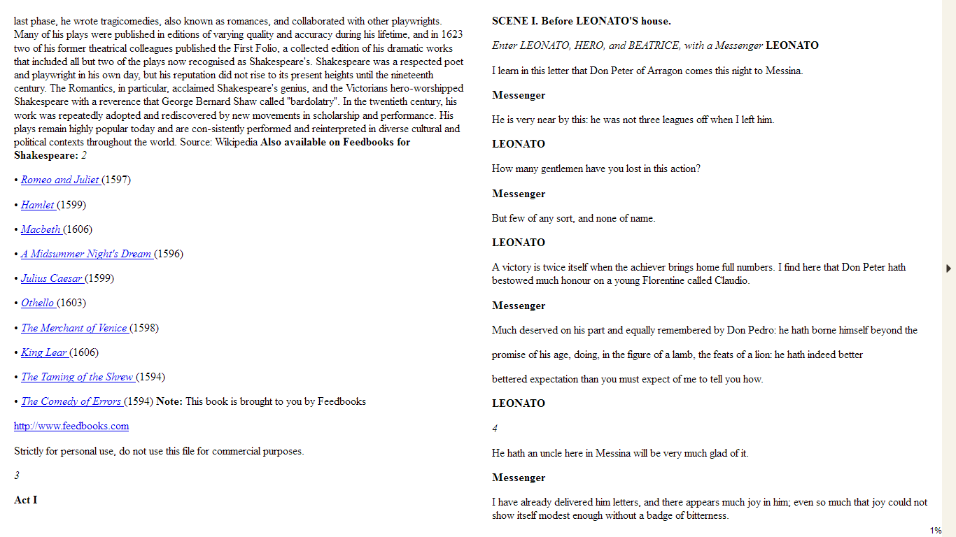

Slide 46
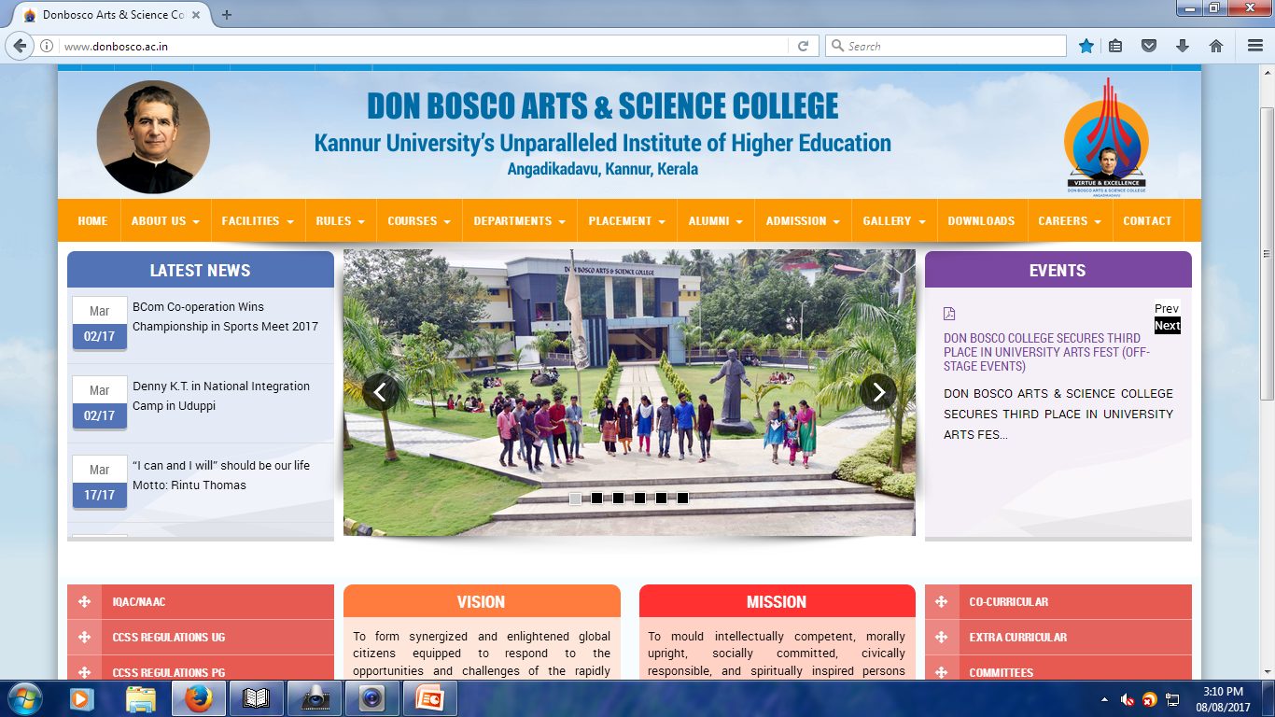

Slide 47
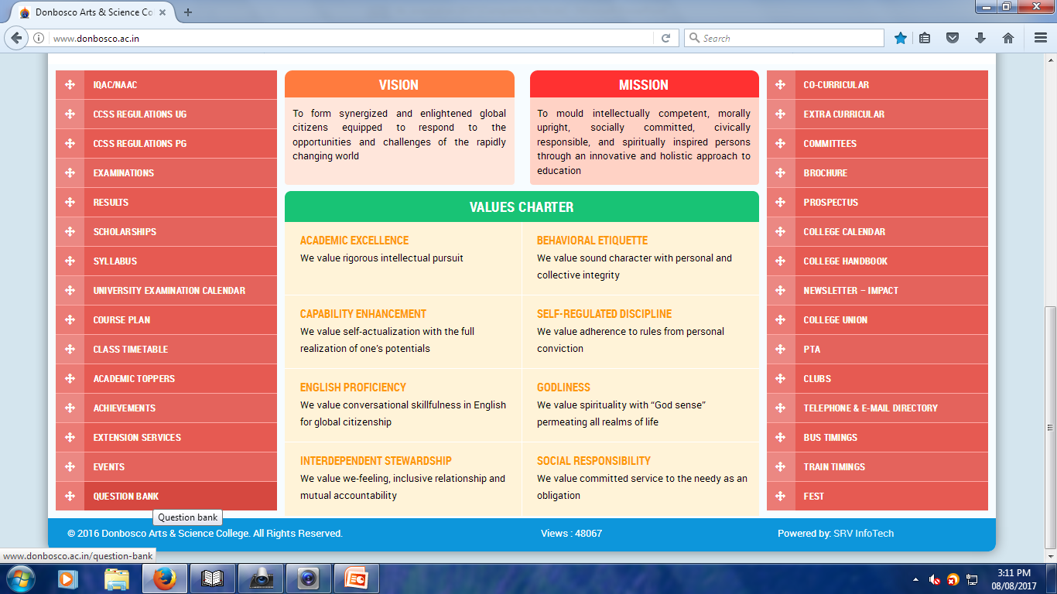

Slide 48
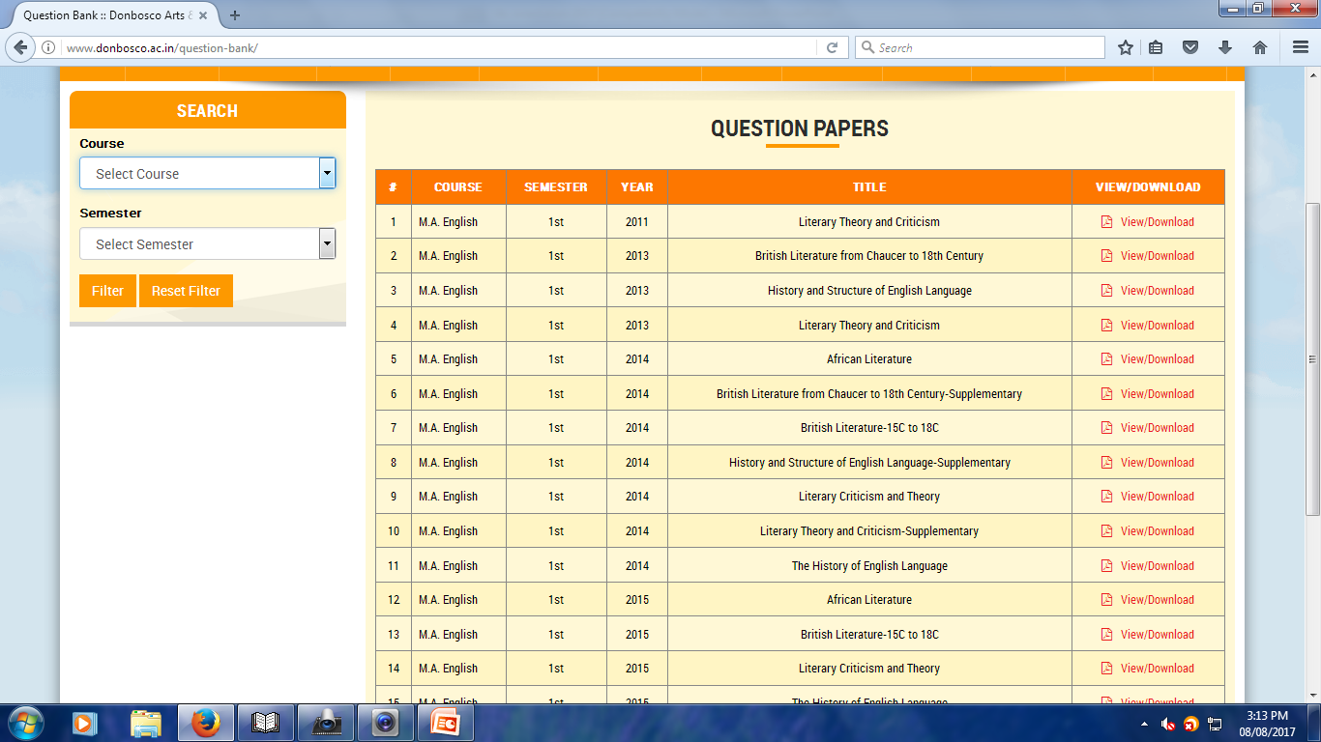

Slide 49


Slide 50
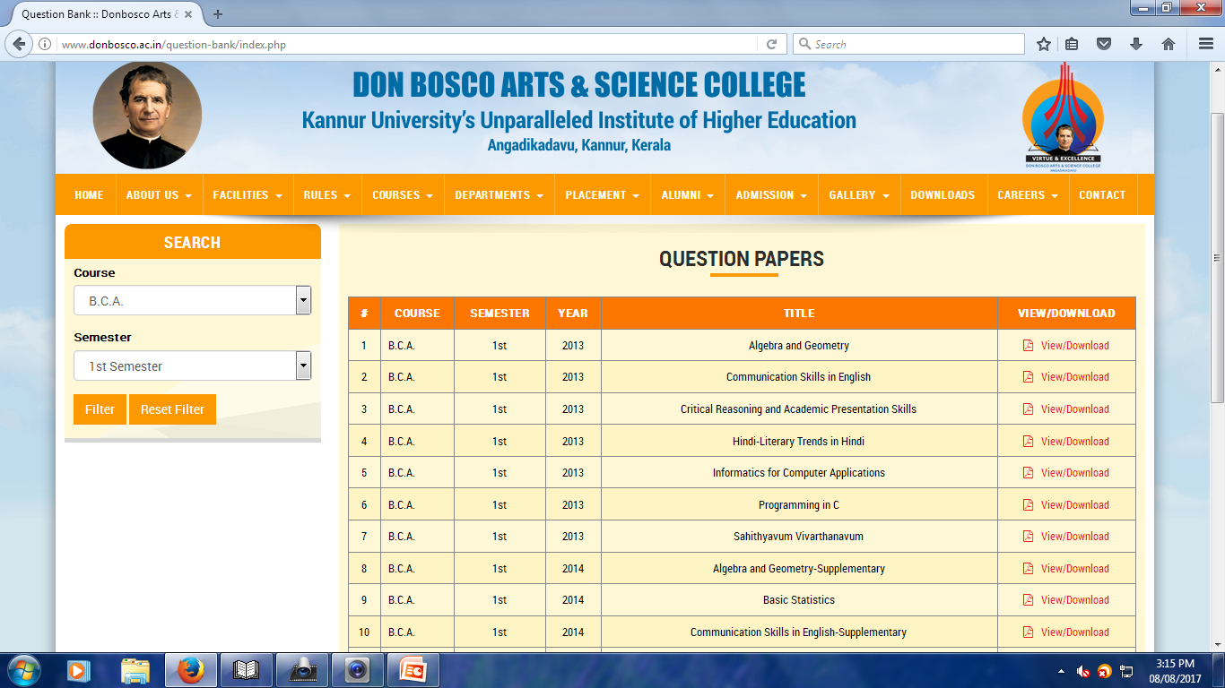

Slide 51
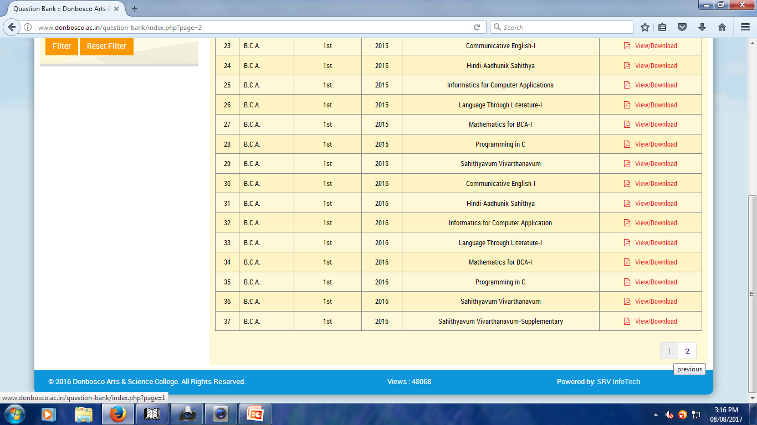

Slide 52
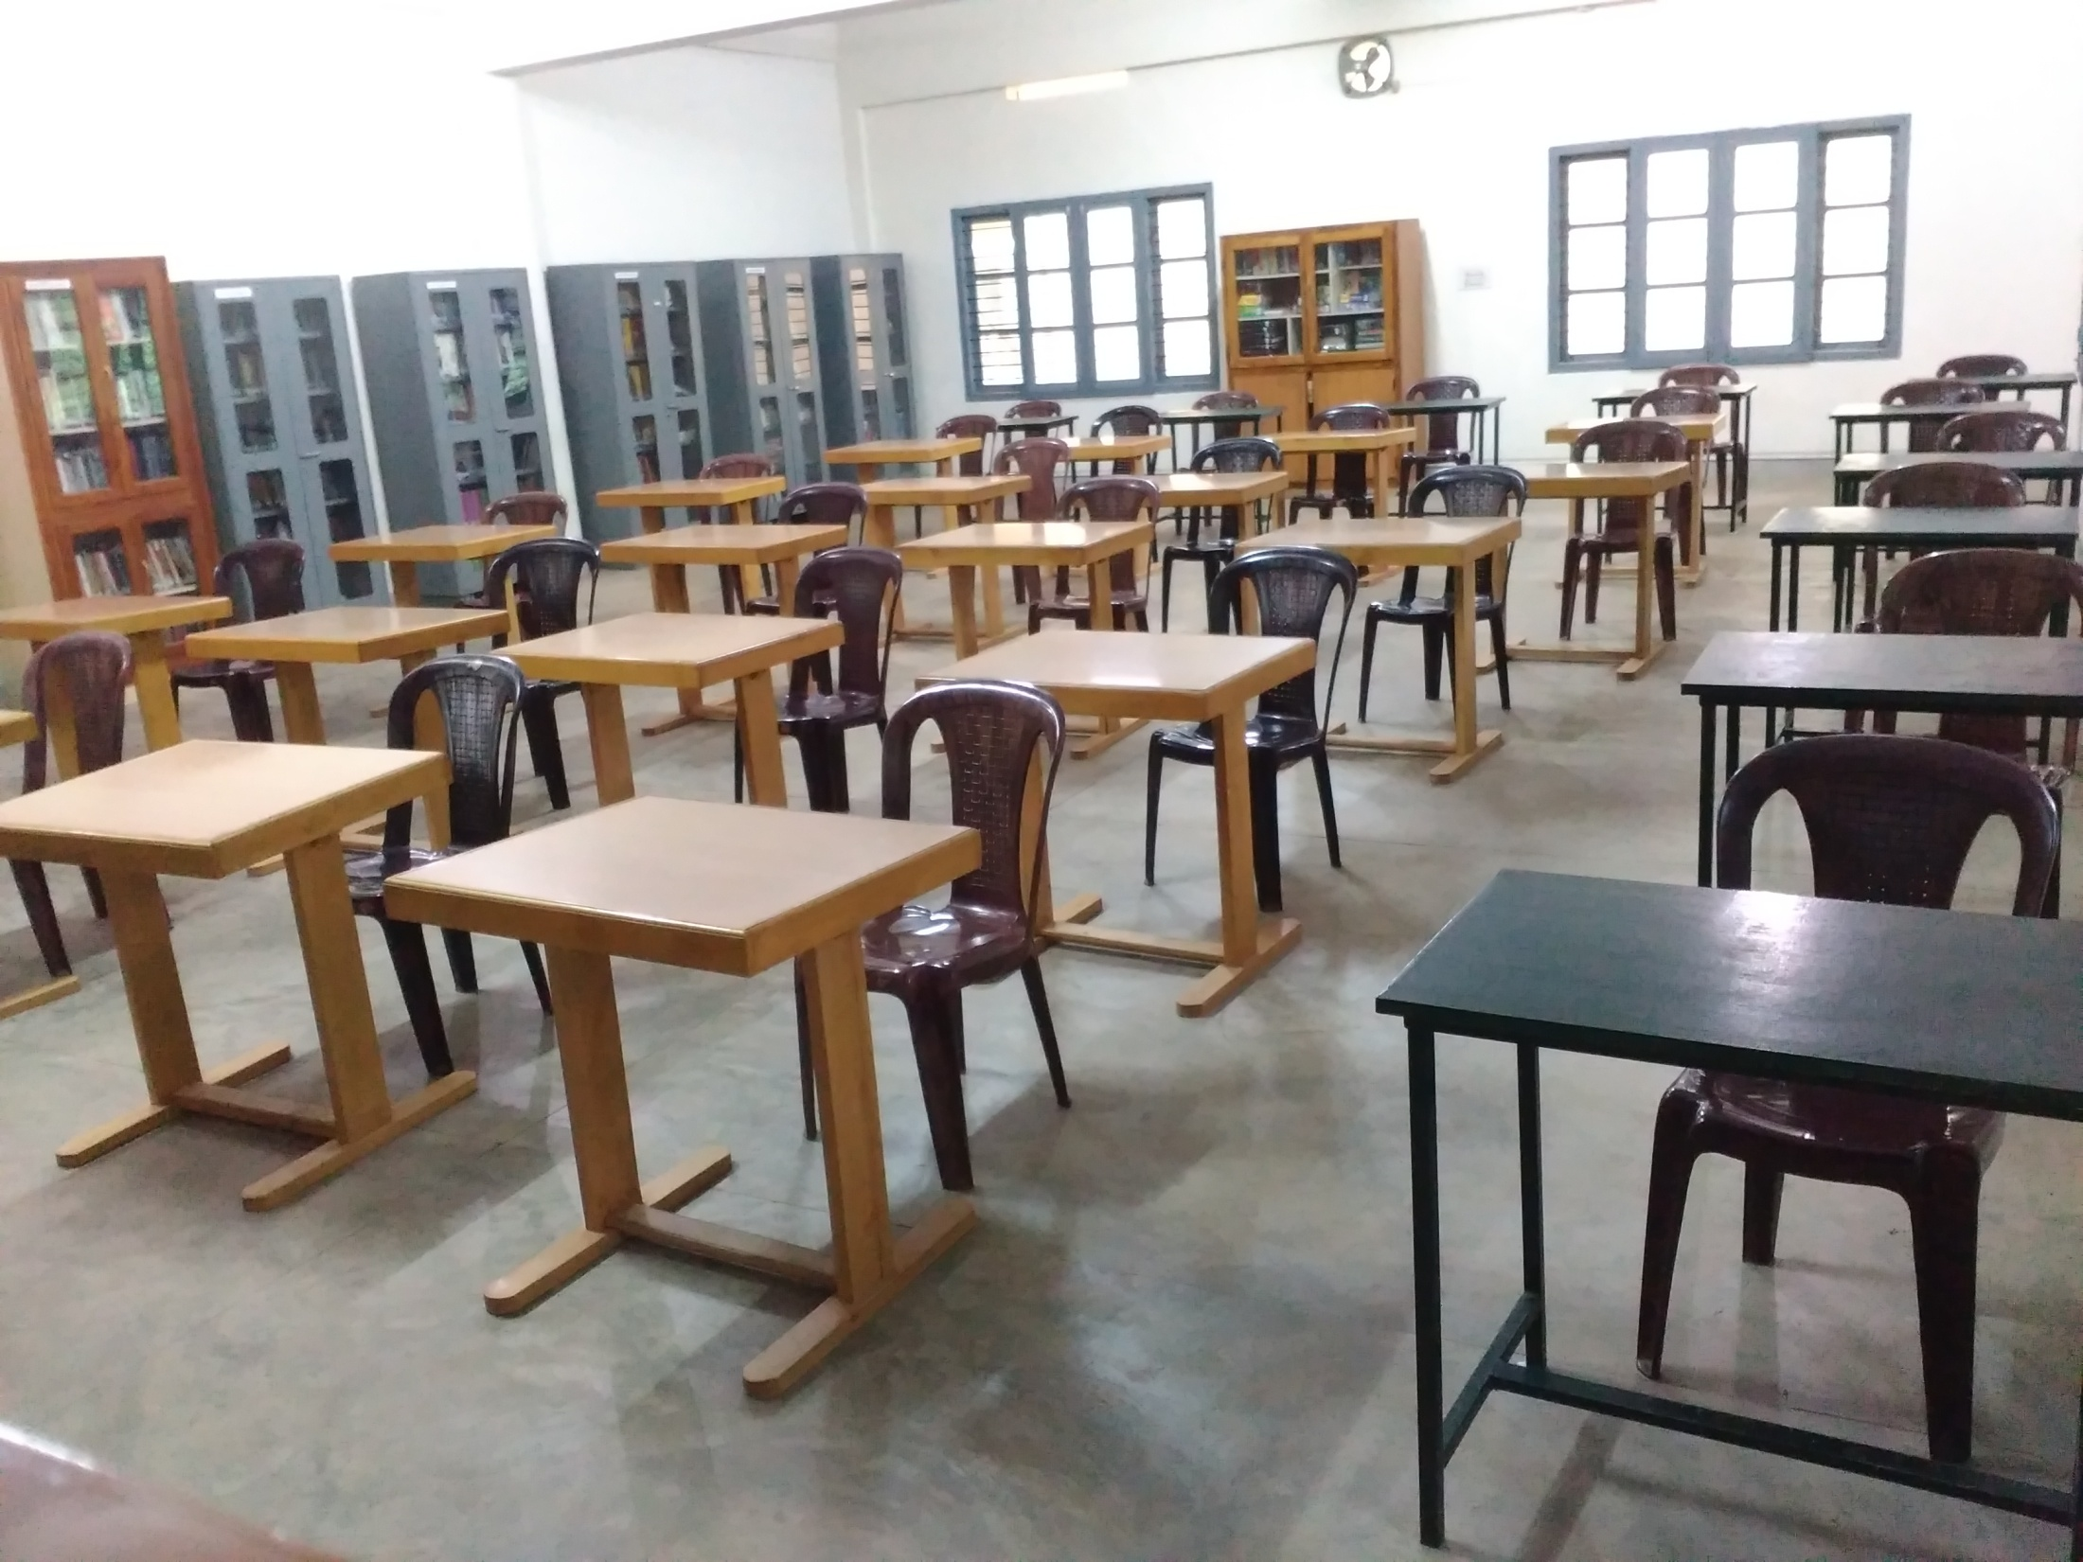

Slide 53
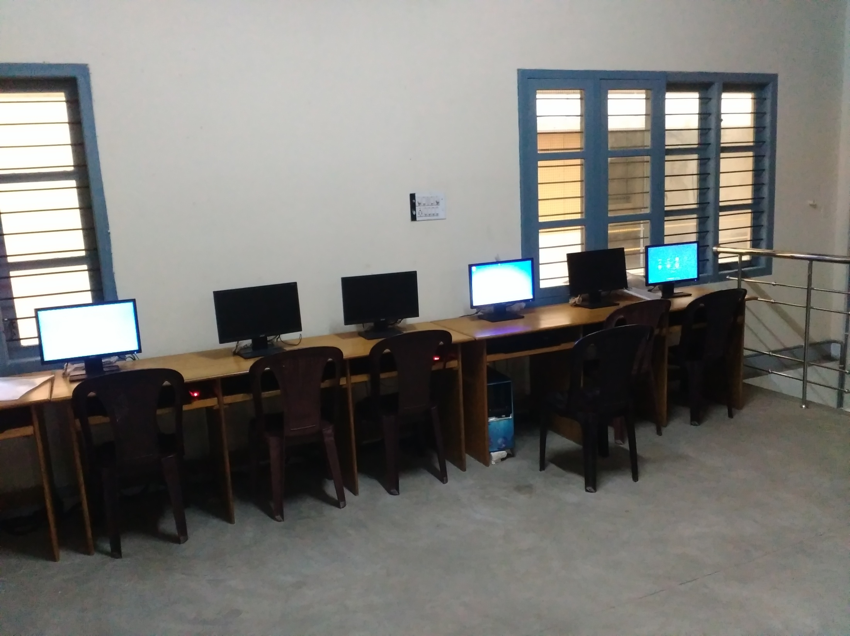

Slide 54


